Slide 1
Bispecific Selectivity Work

Slide 2
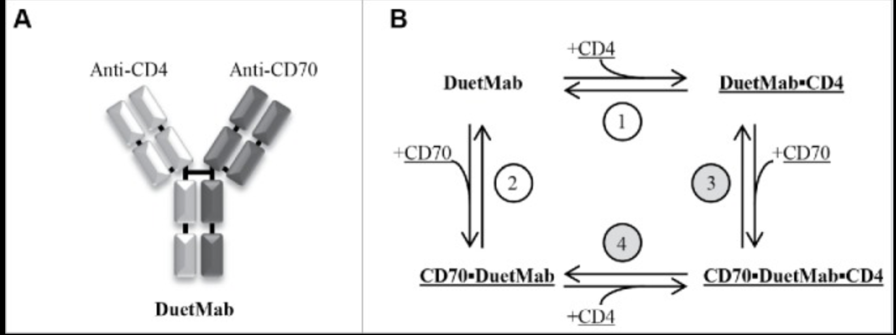

Slide 3
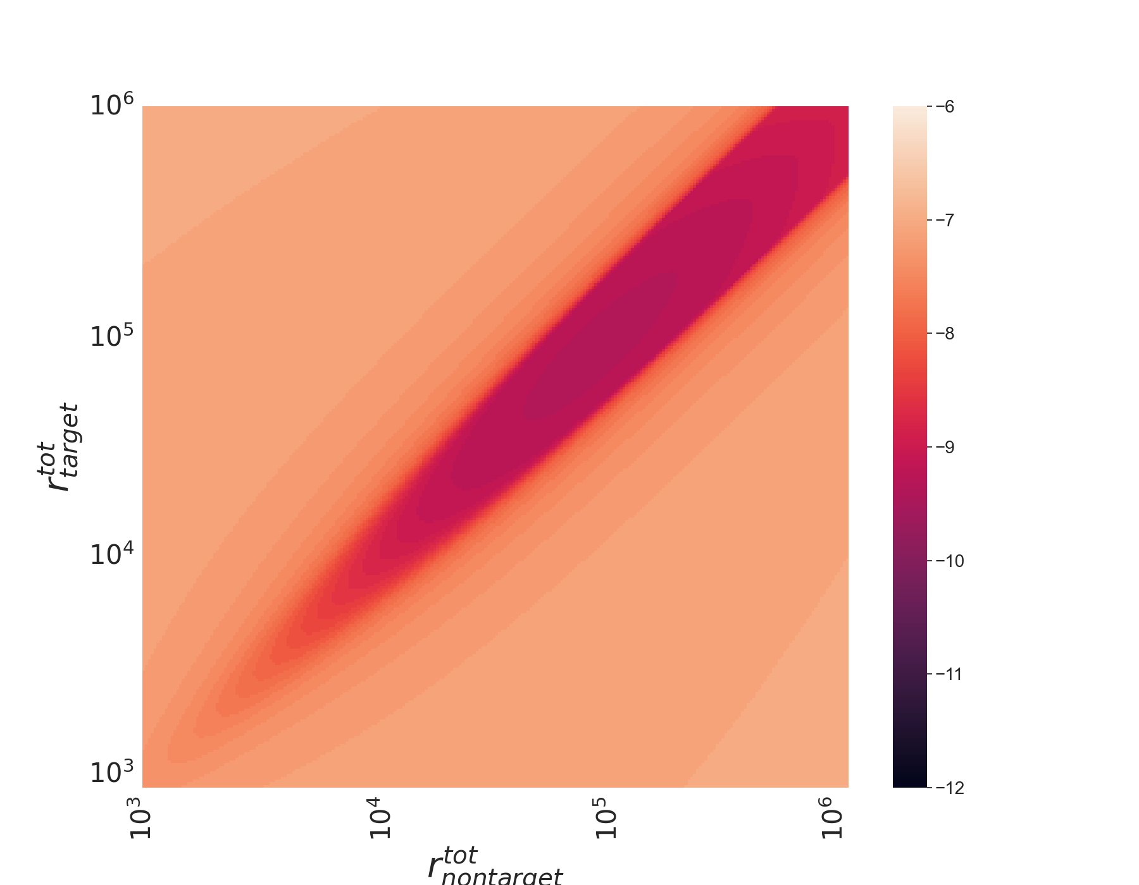
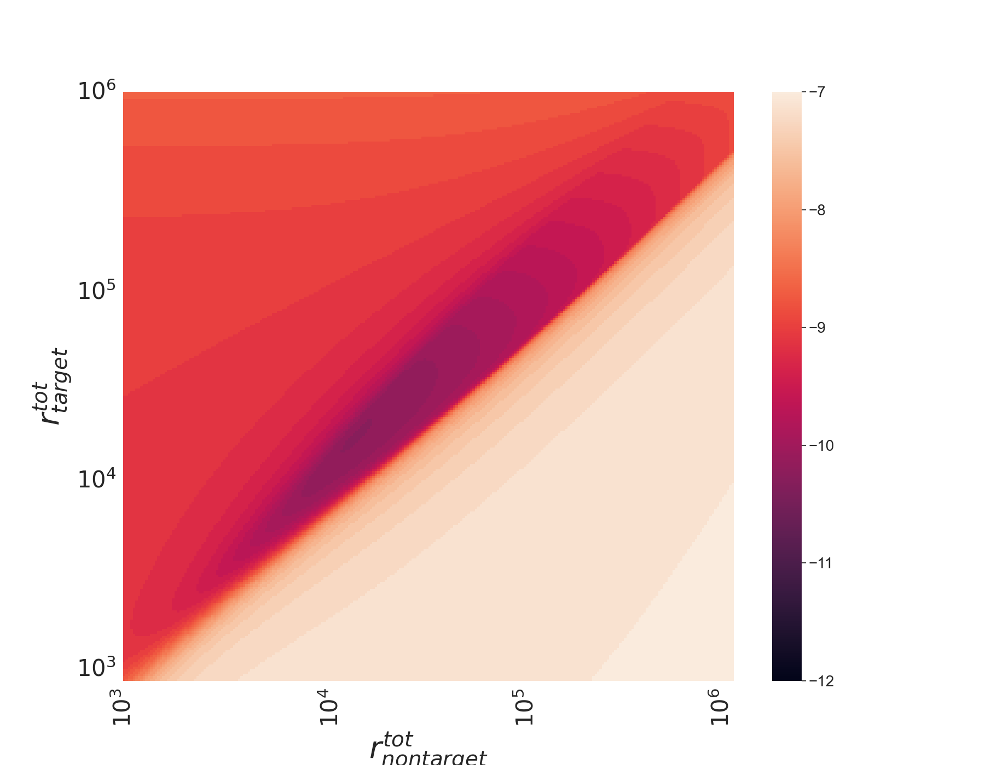
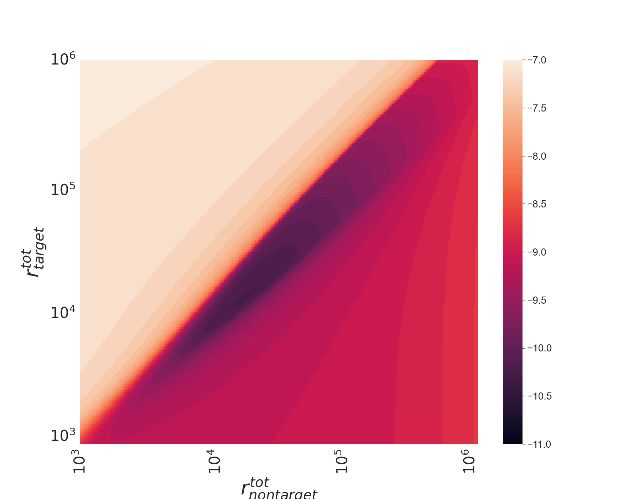
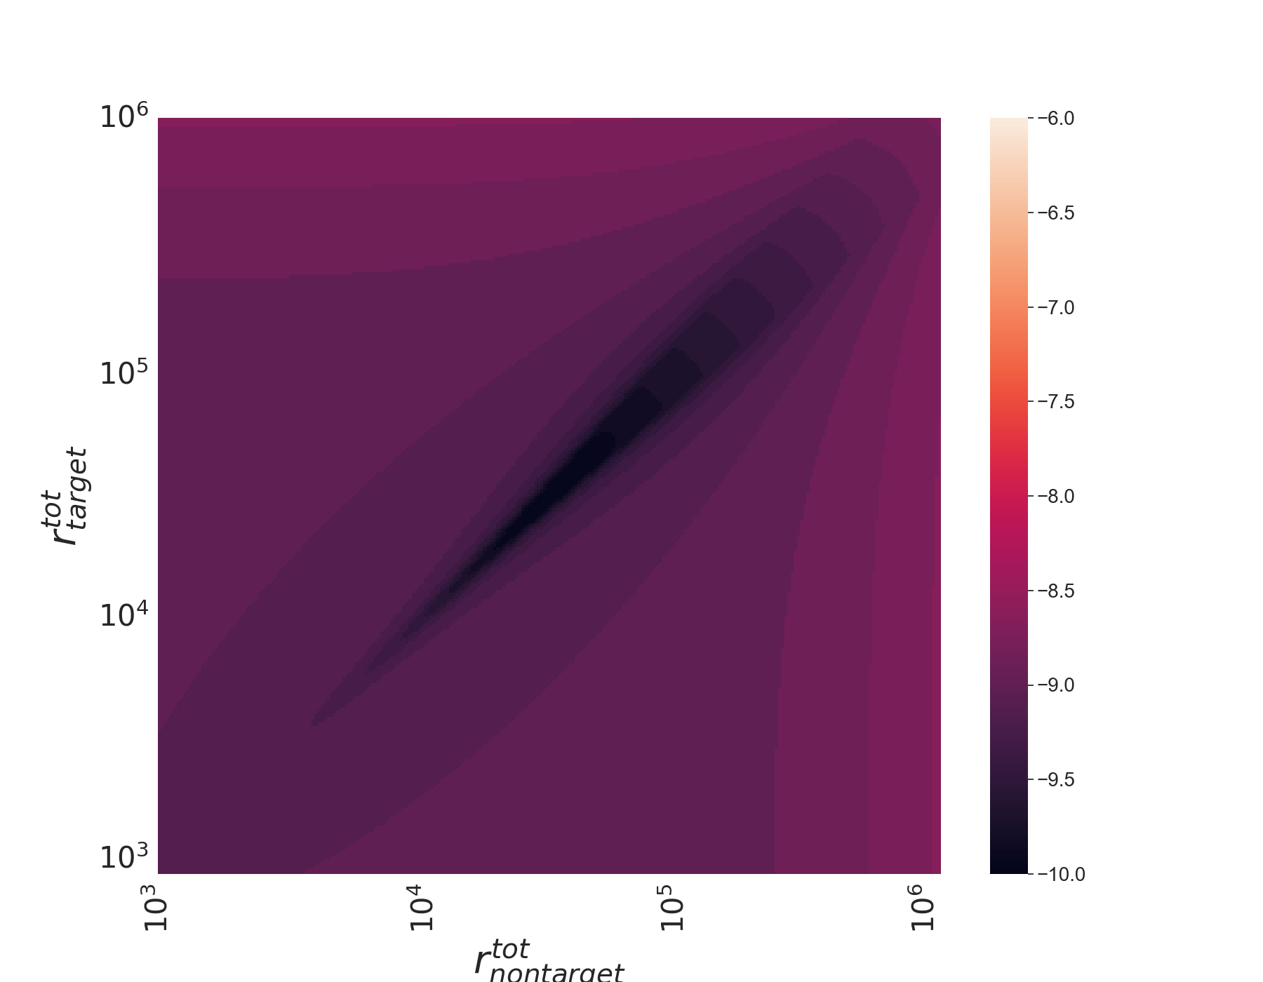
EC50 plots
1nm 100nm
100nm 100nm
100nm 1nm
1nm 1nm

Slide 4
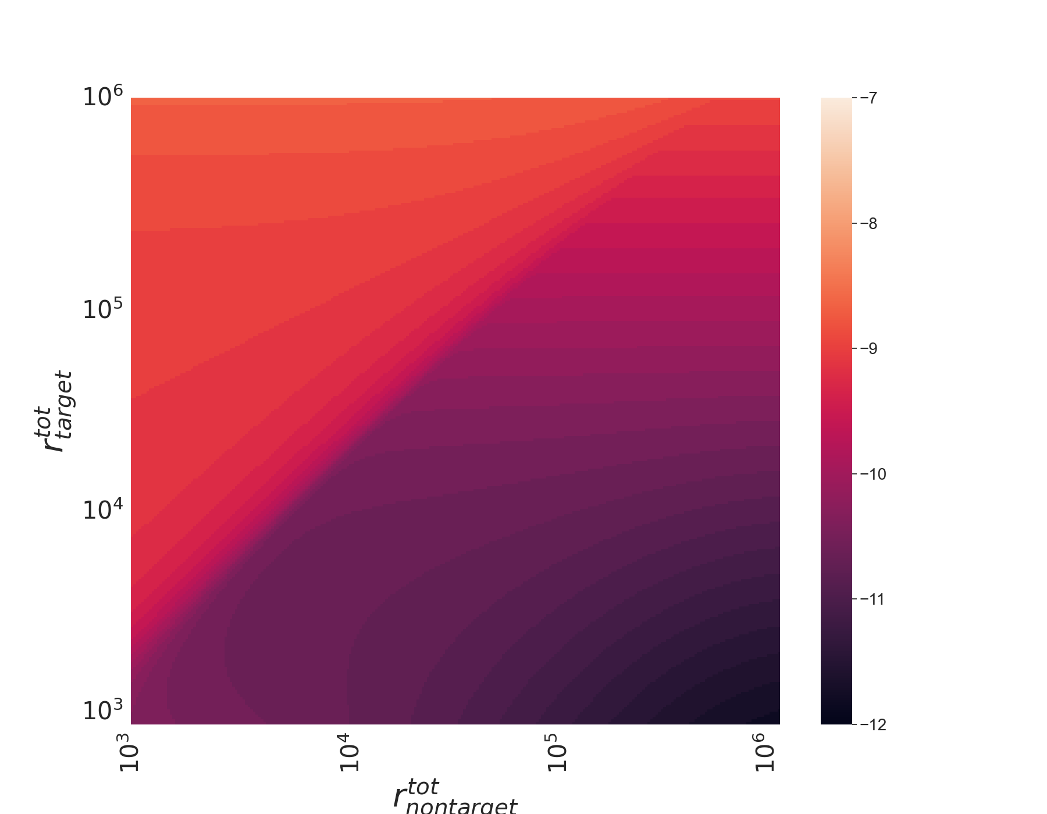
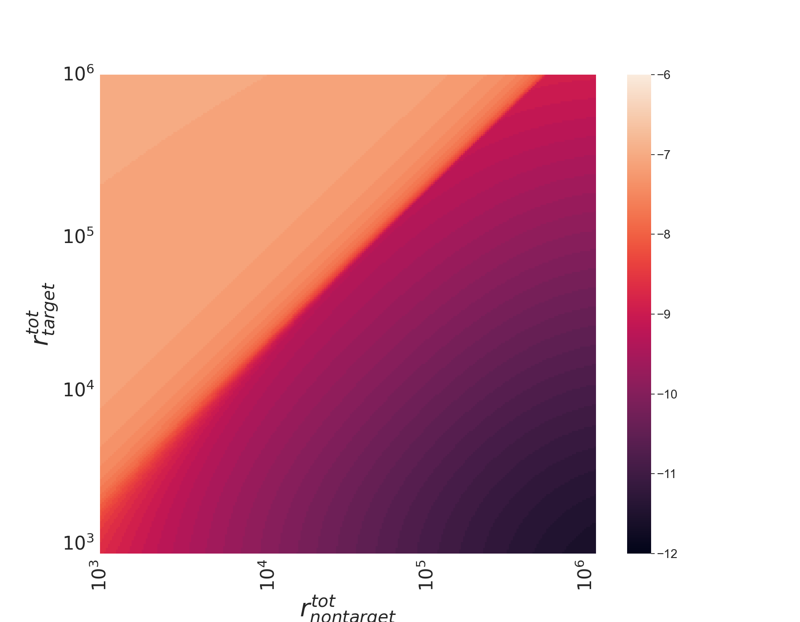
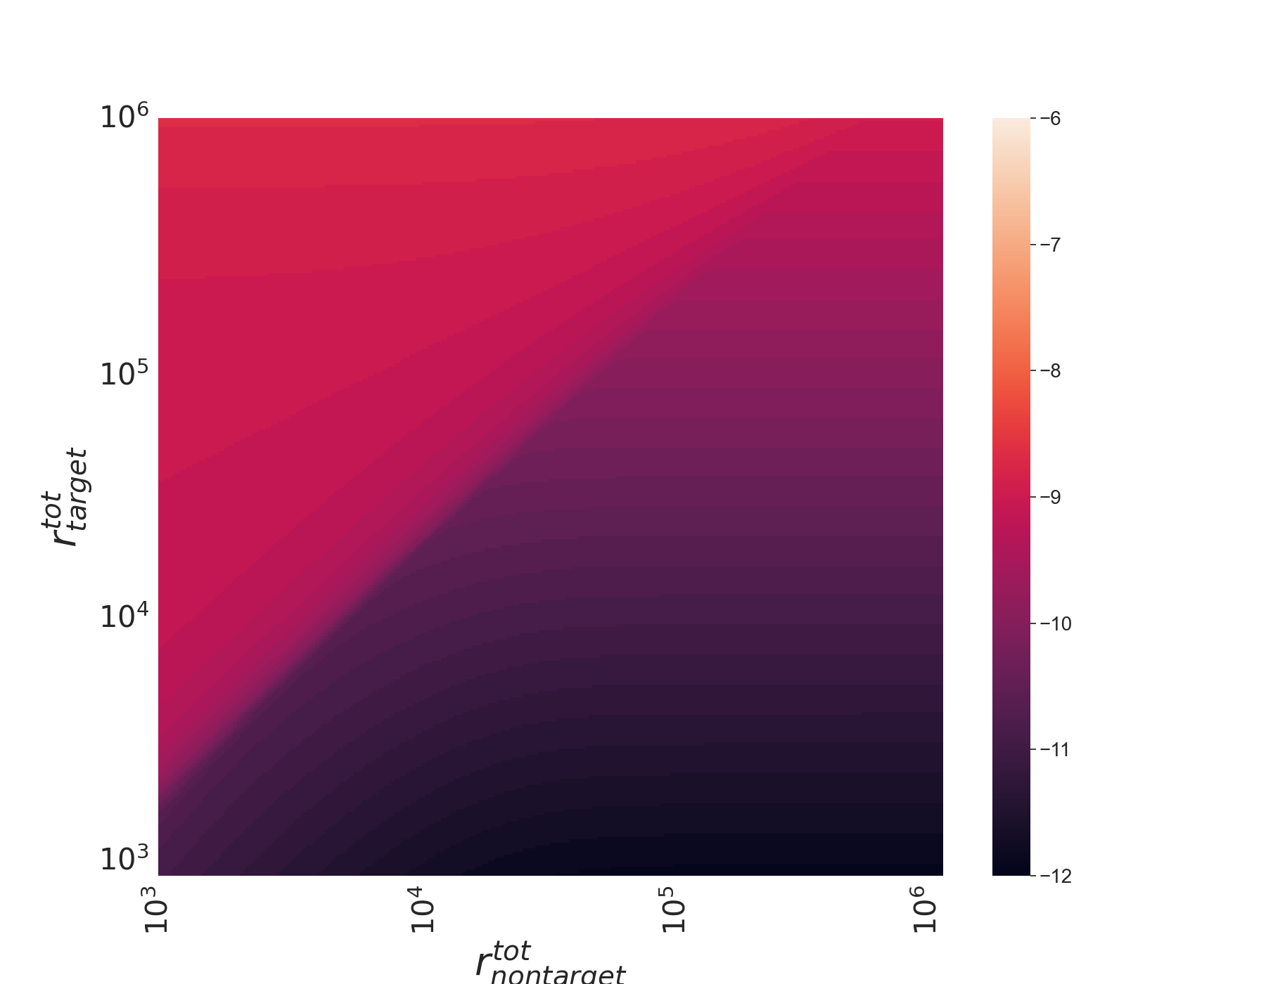
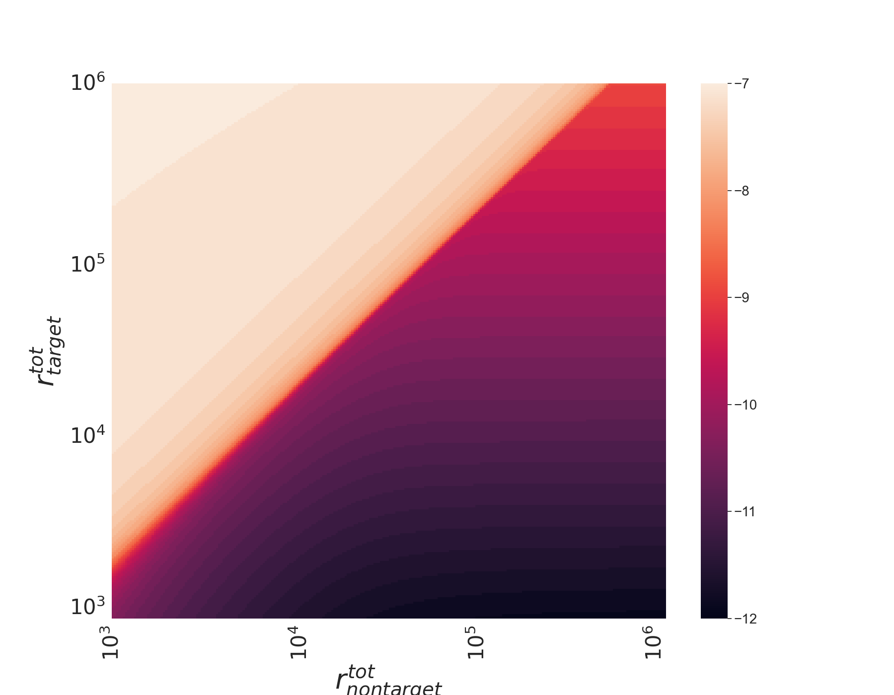
100nm 100nm
1nm 100nm
1nm 1nm
100nm 1nm

Slide 5
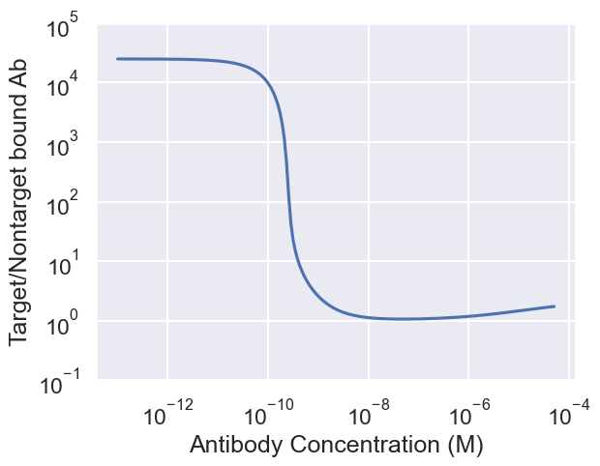
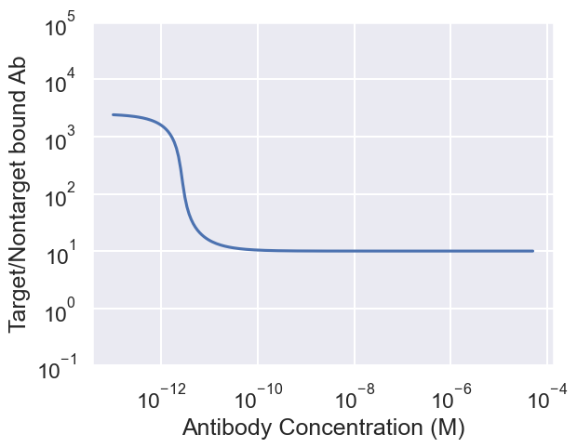

Slide 6
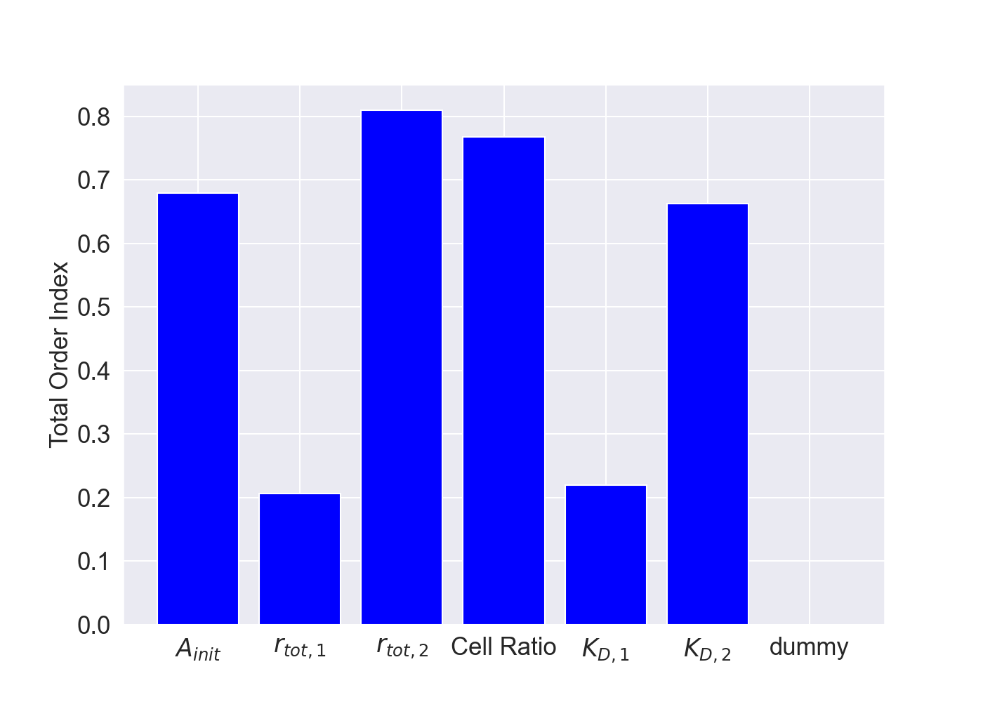
Selectivity Sensitivity Analysis
Target receptor associated parameters
not as important

Slide 7
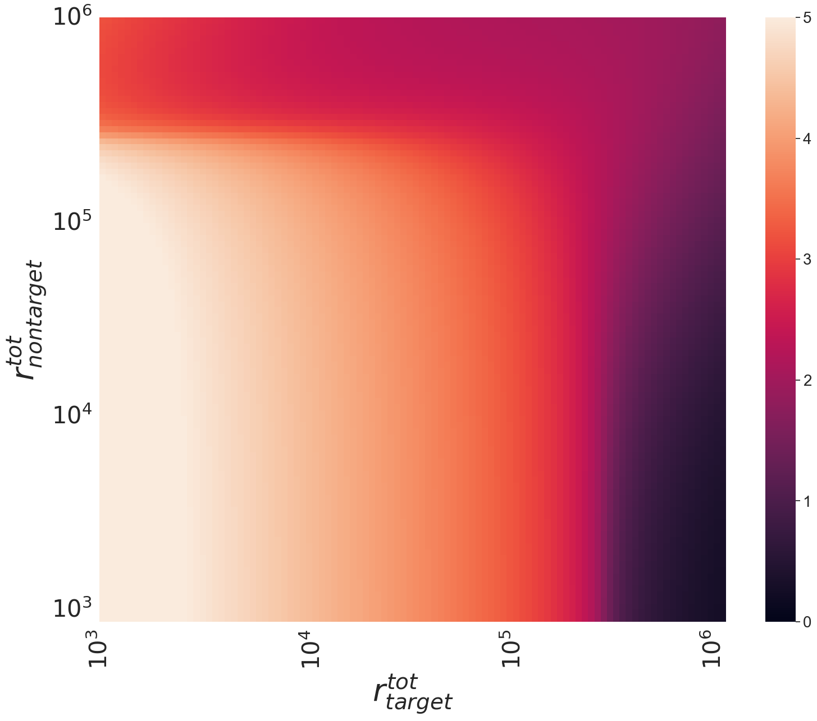
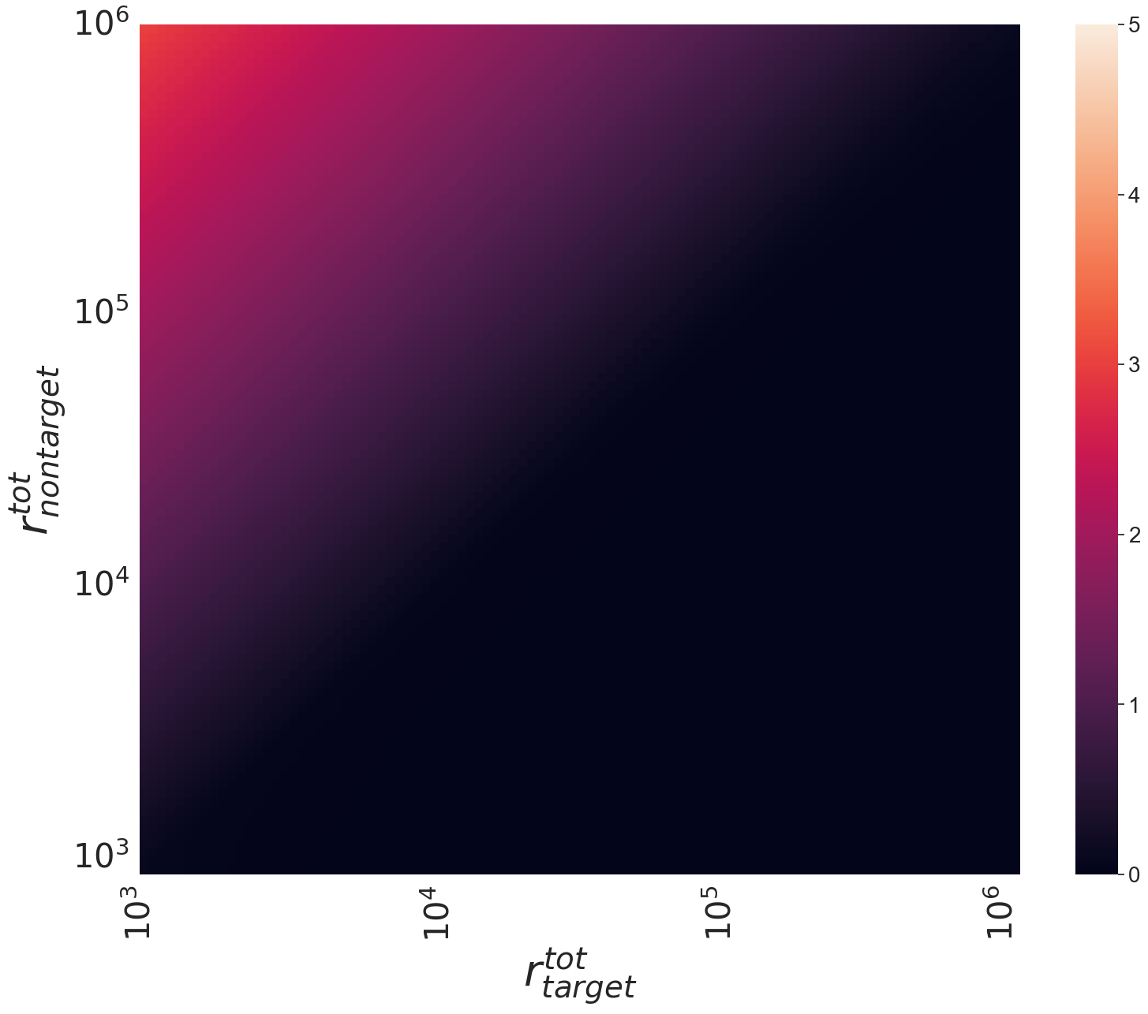
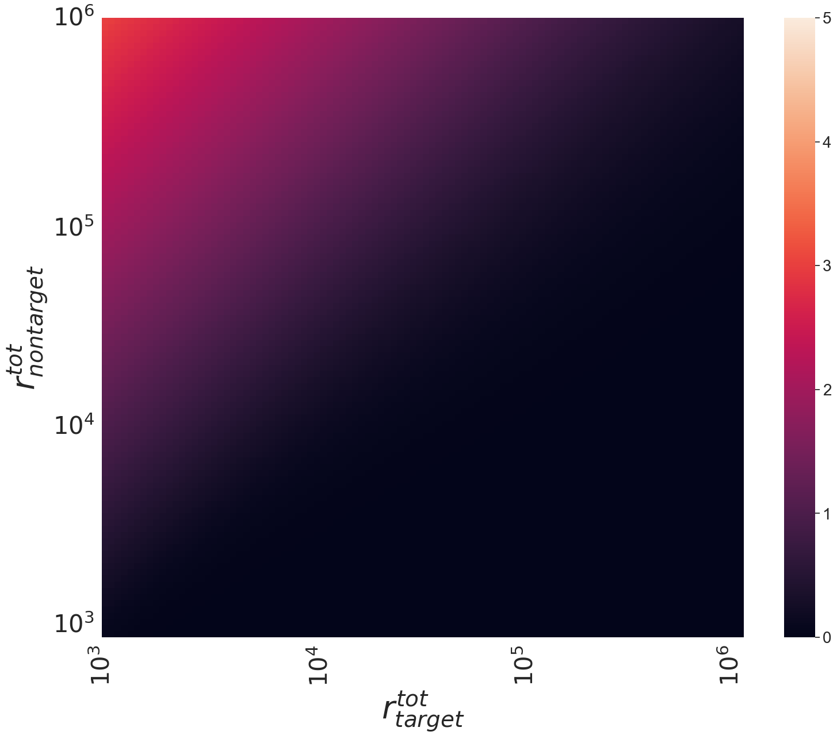

Slide 8
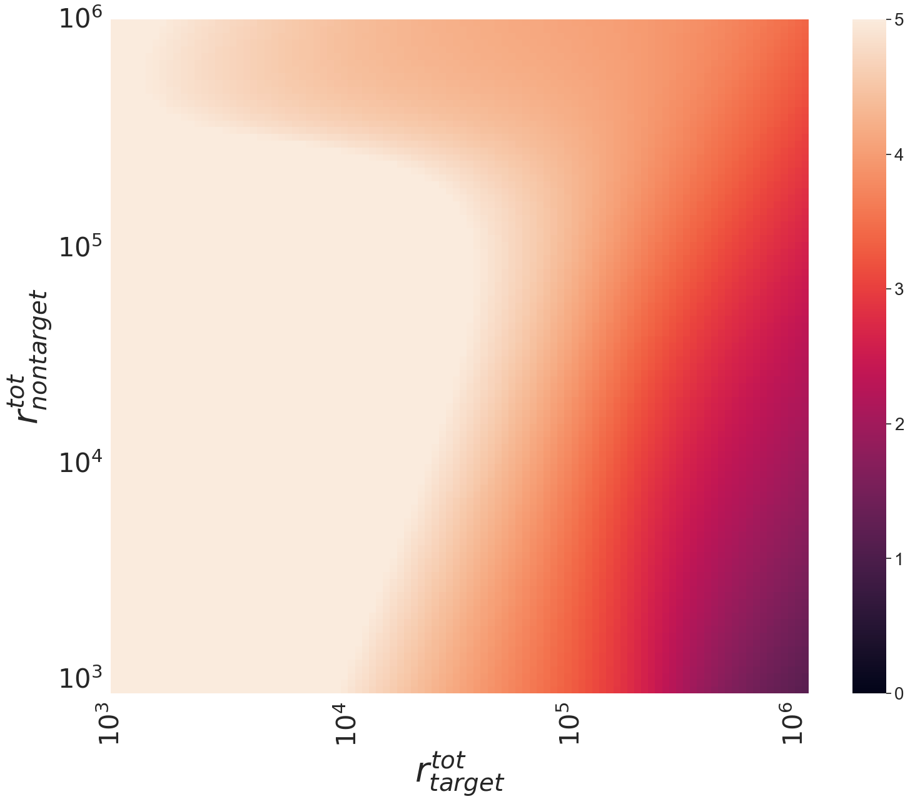
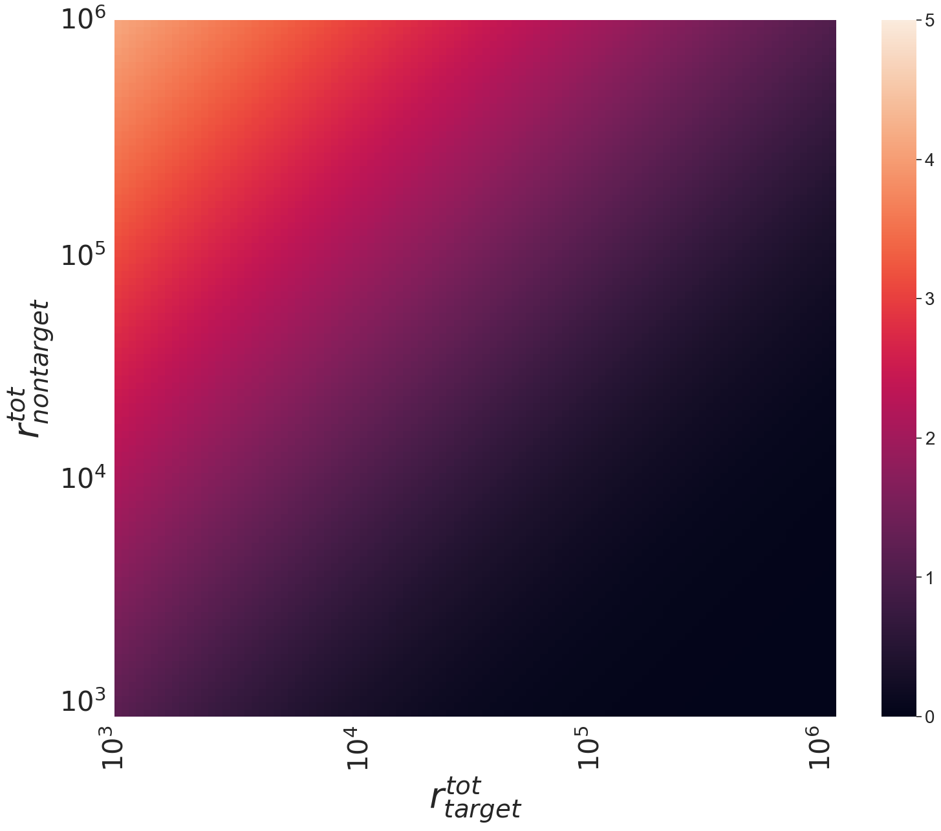

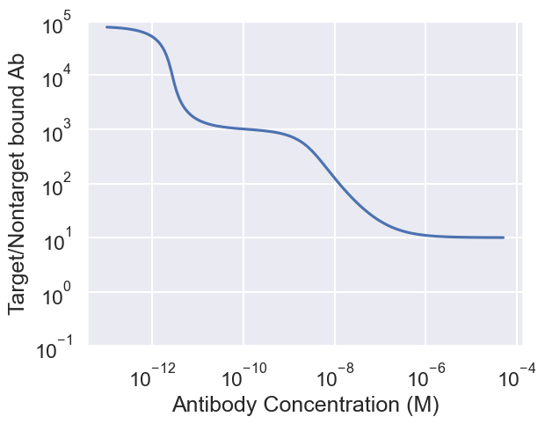

Slide 10
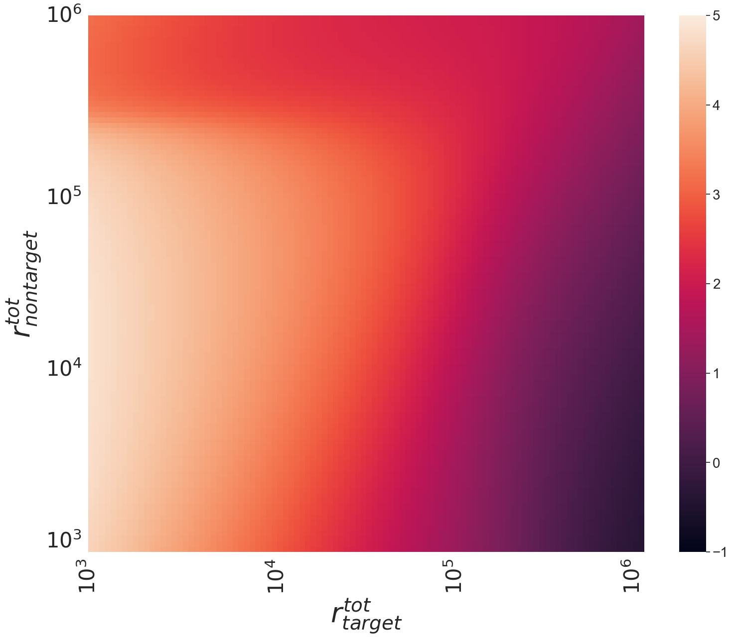
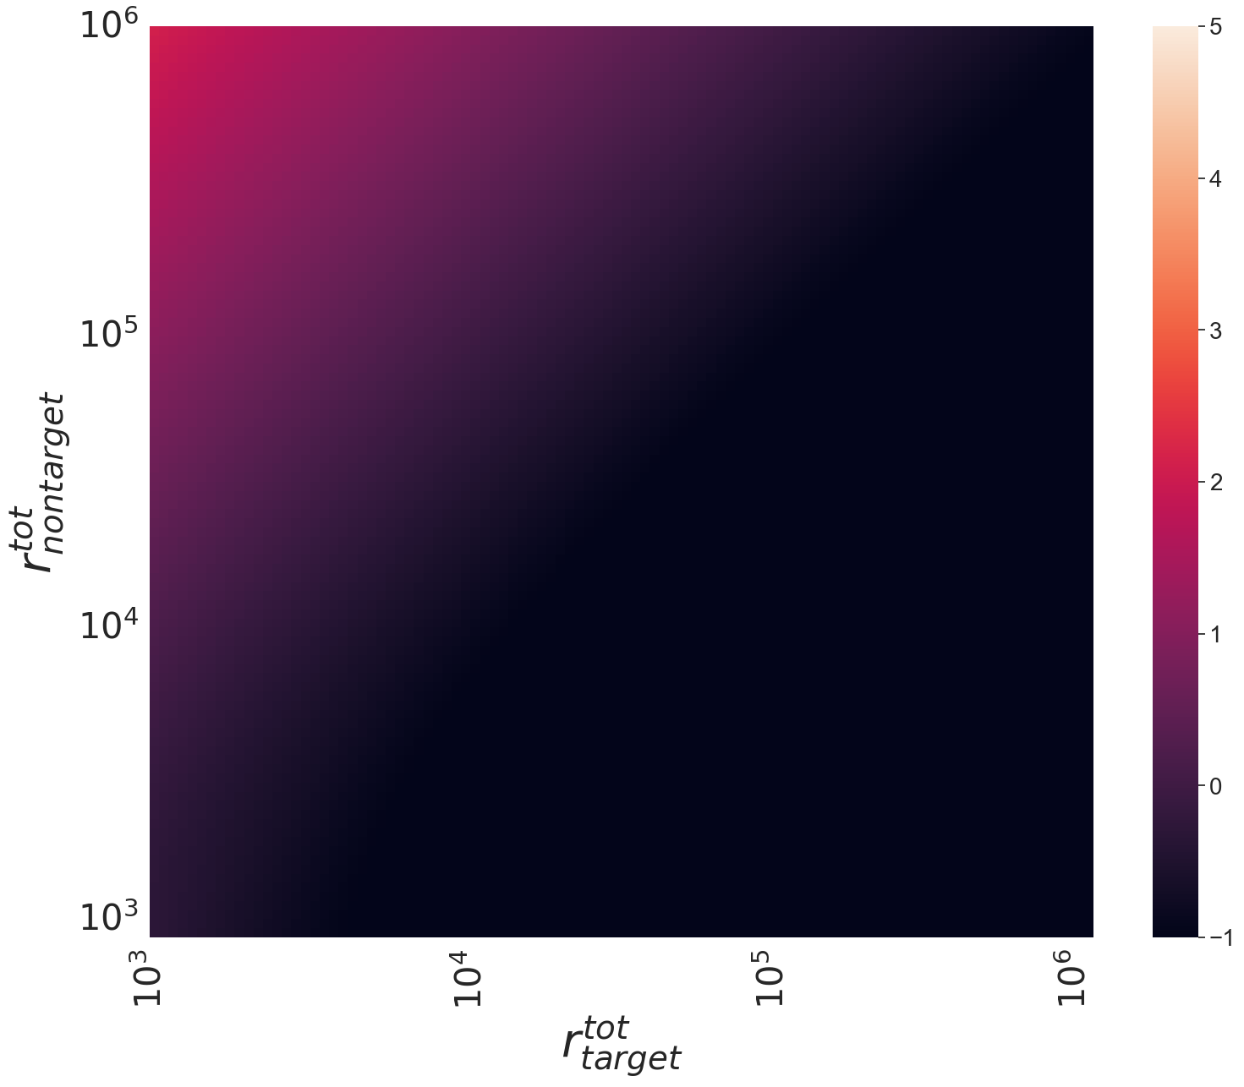
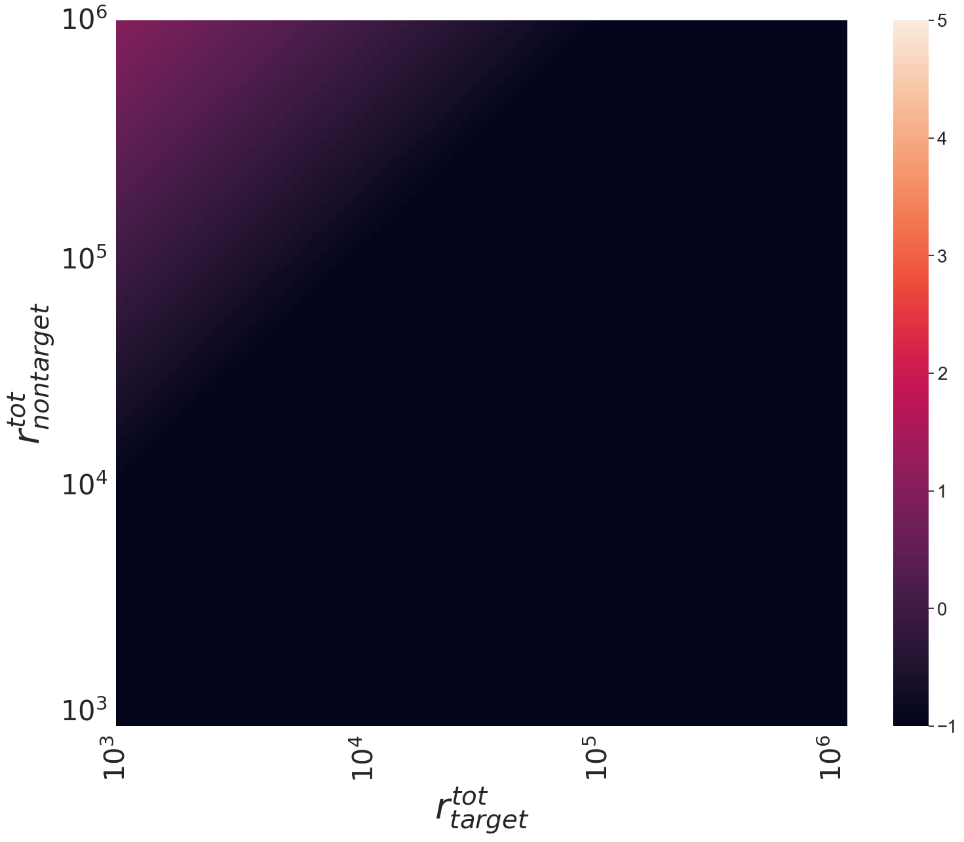
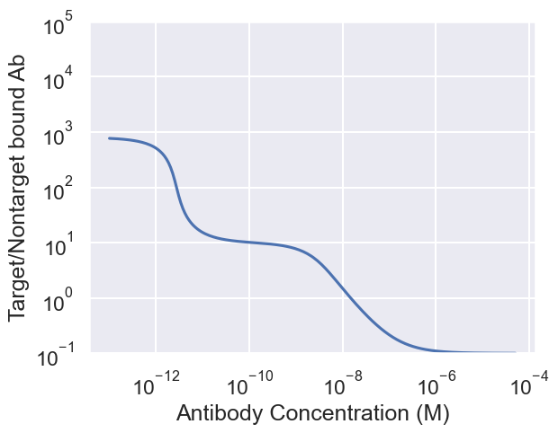

Slide 11
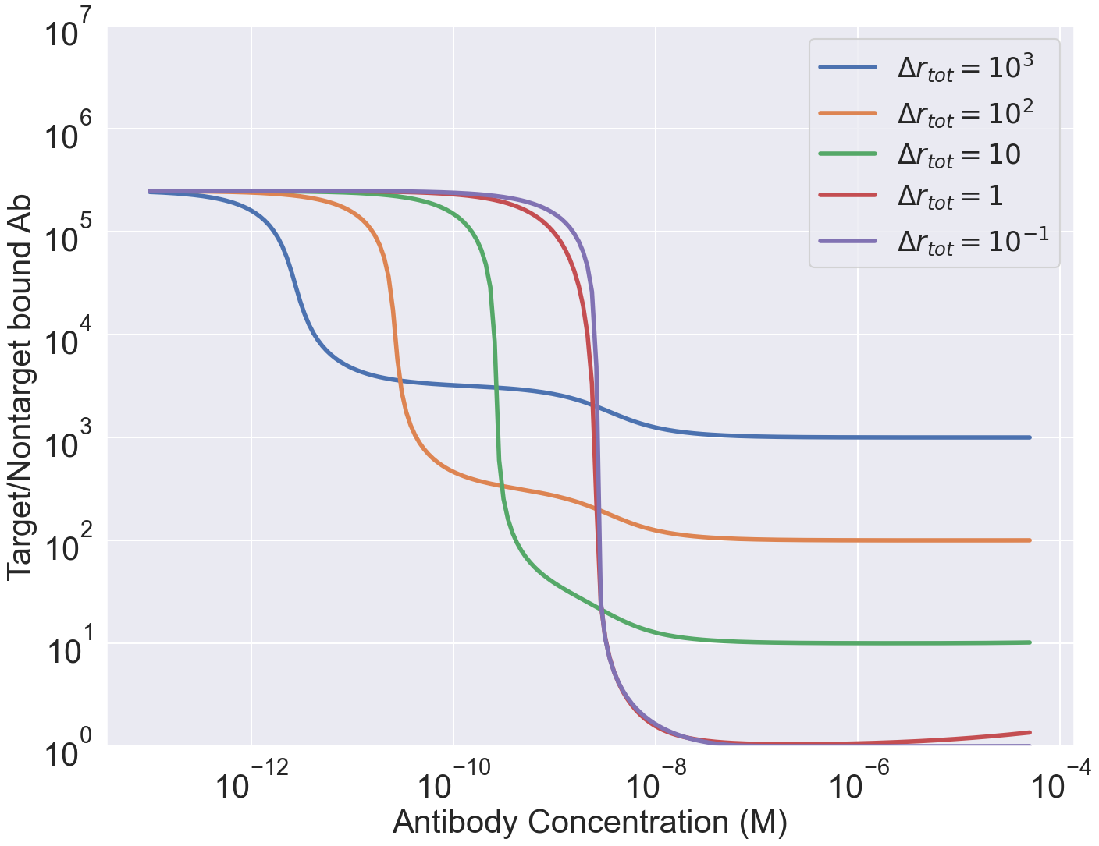
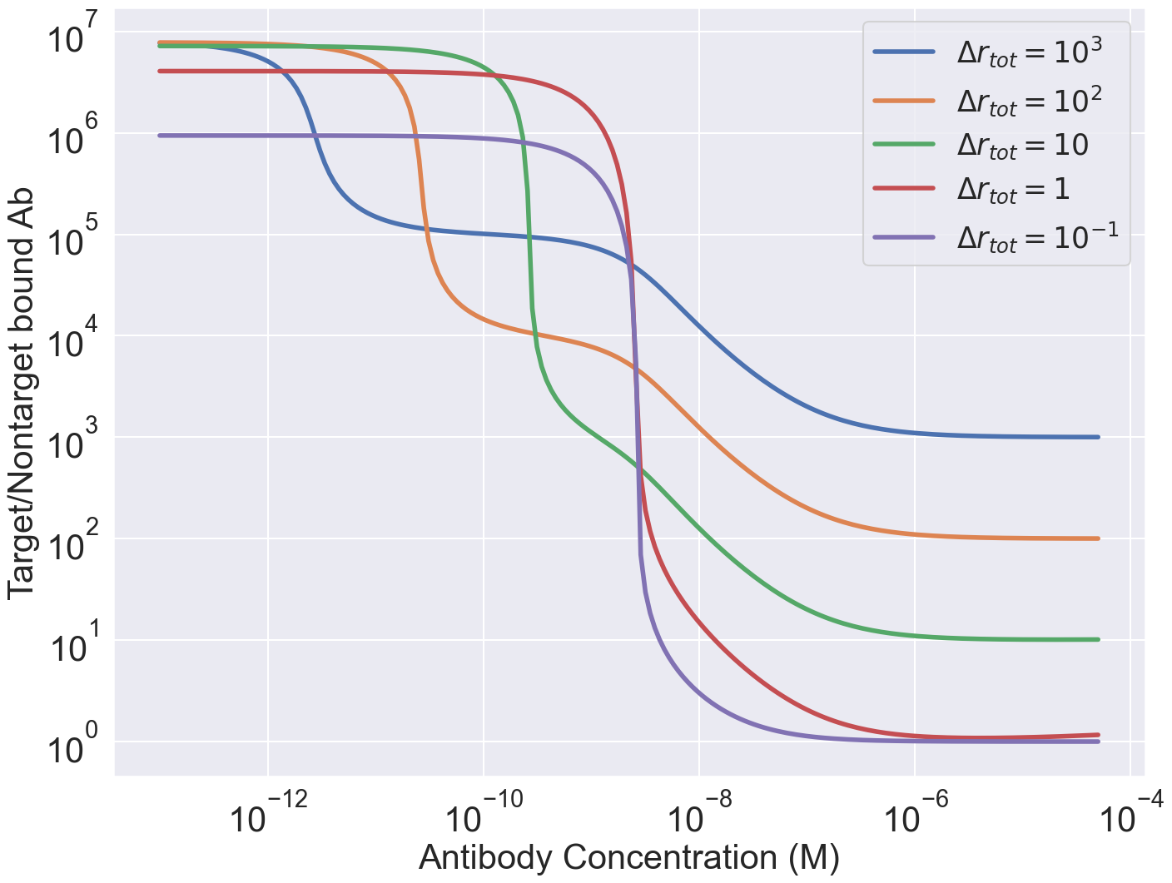

Slide 12
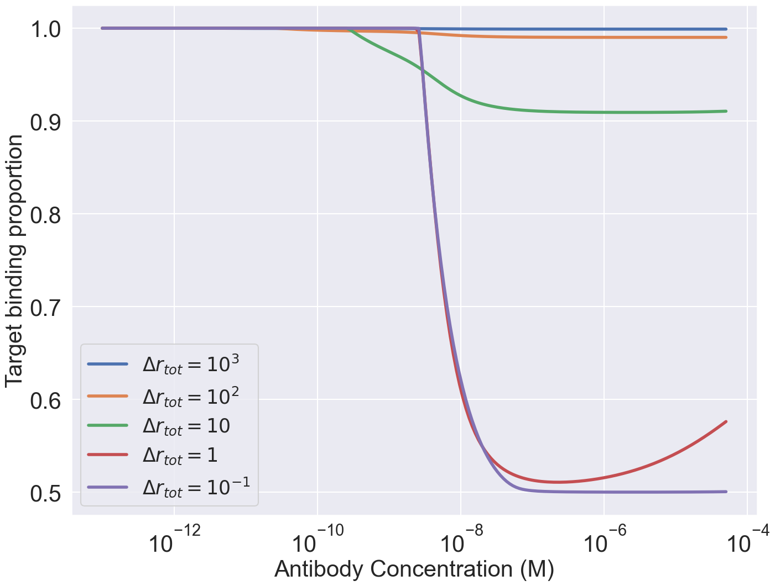
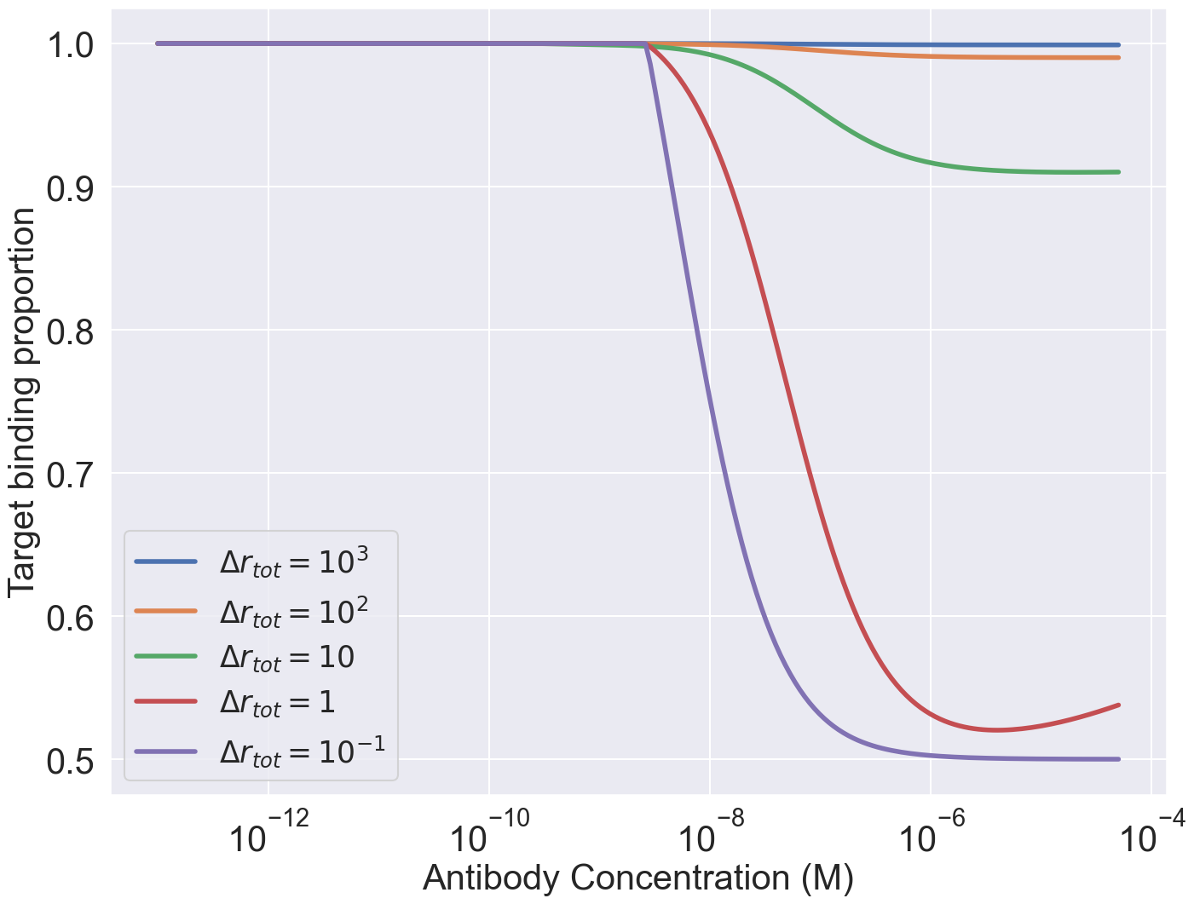

Slide 13
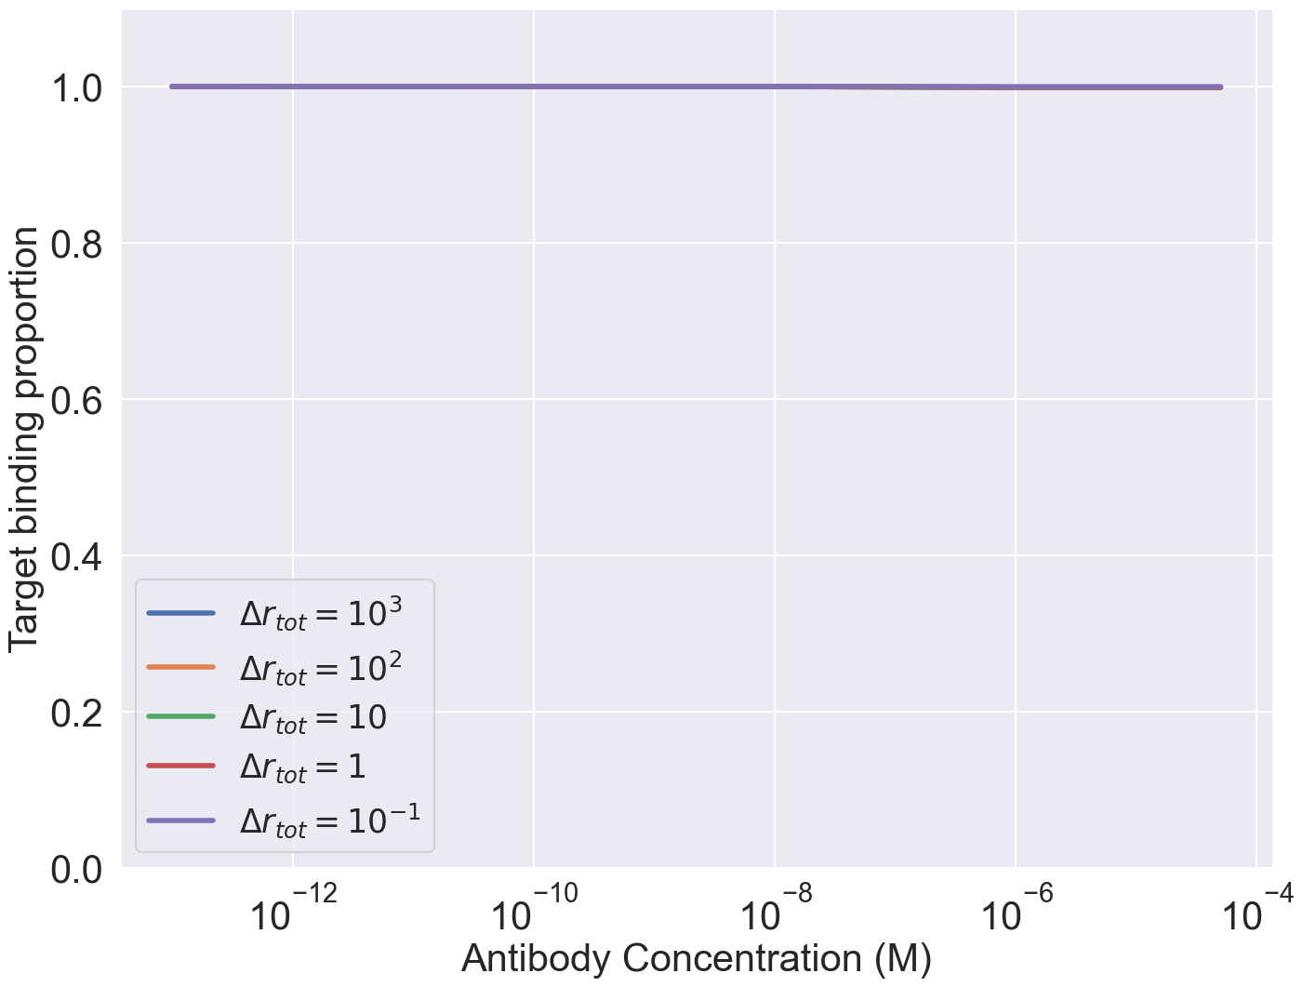
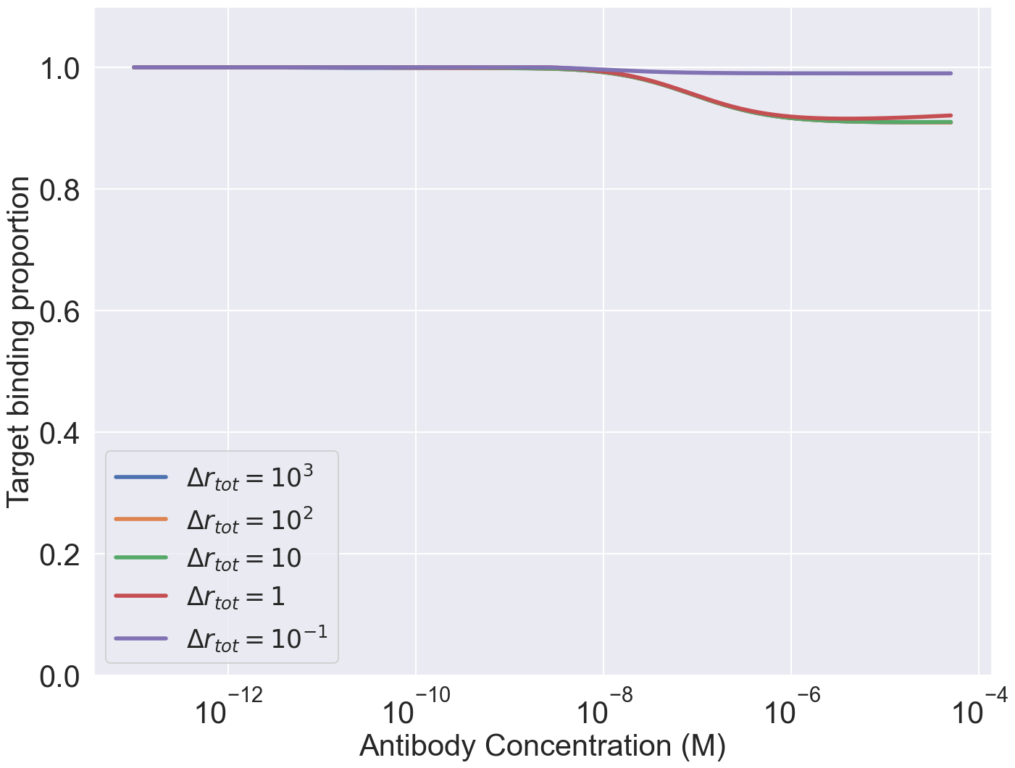
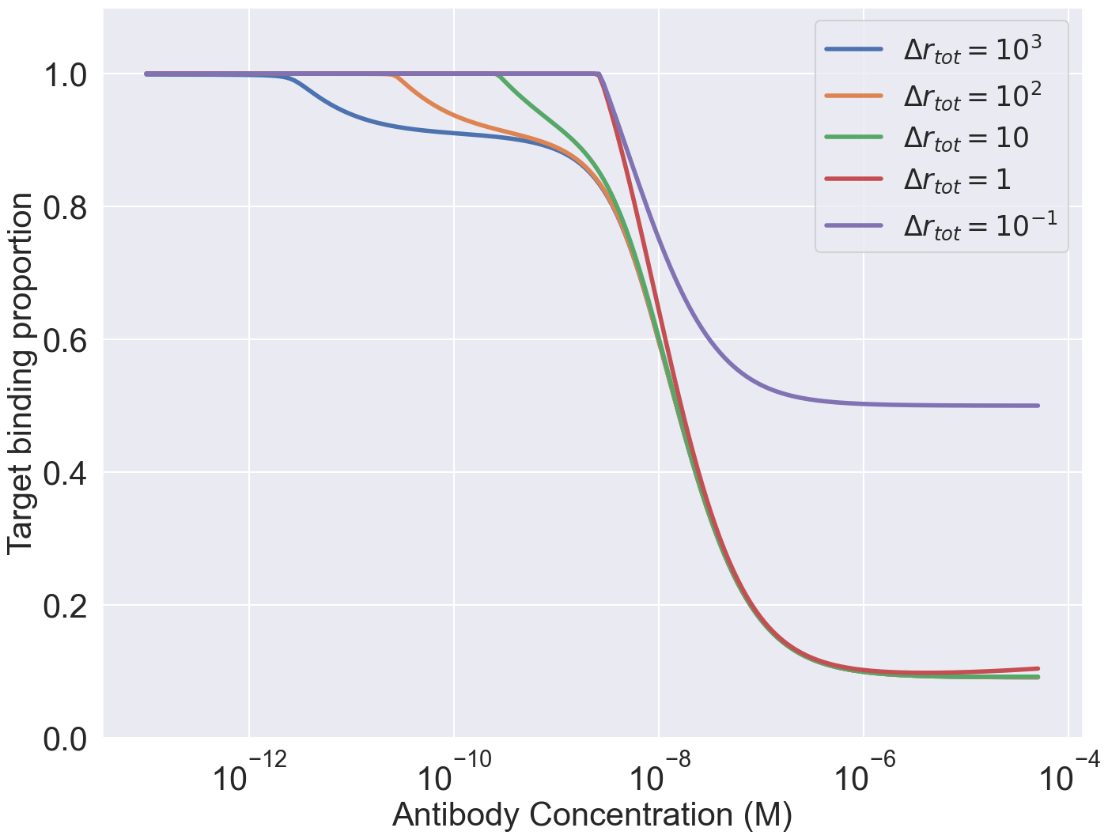

Slide 14
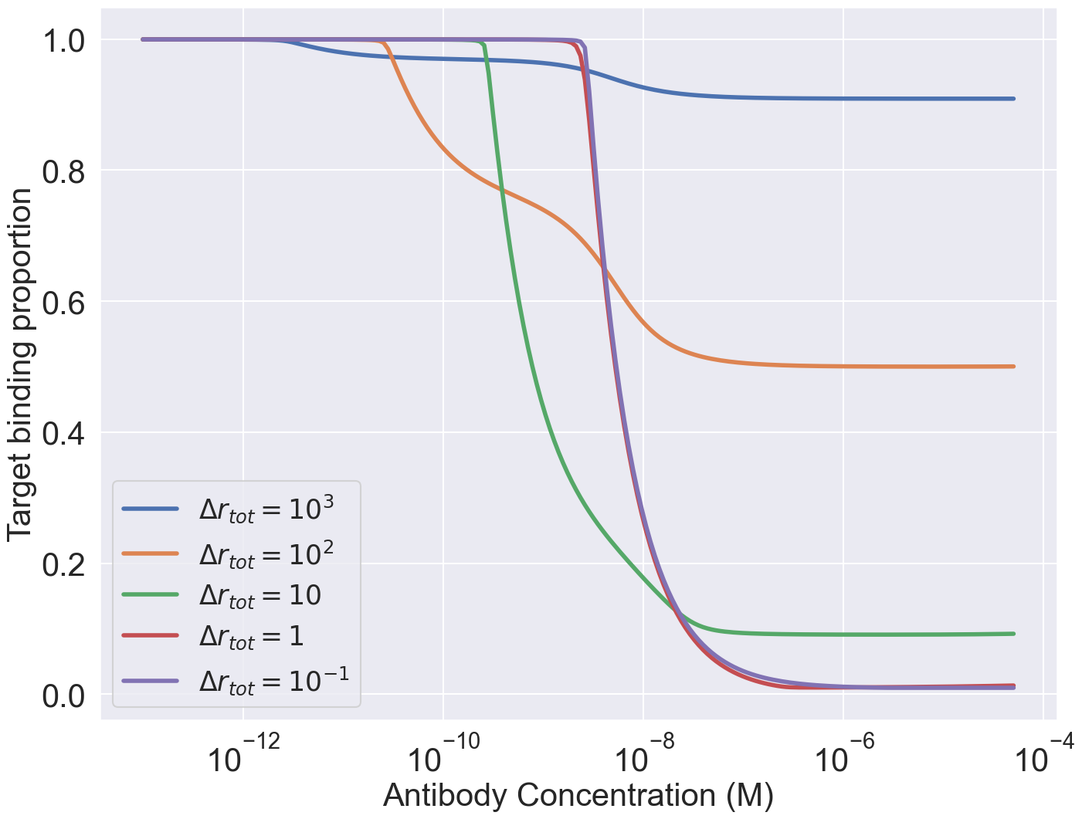
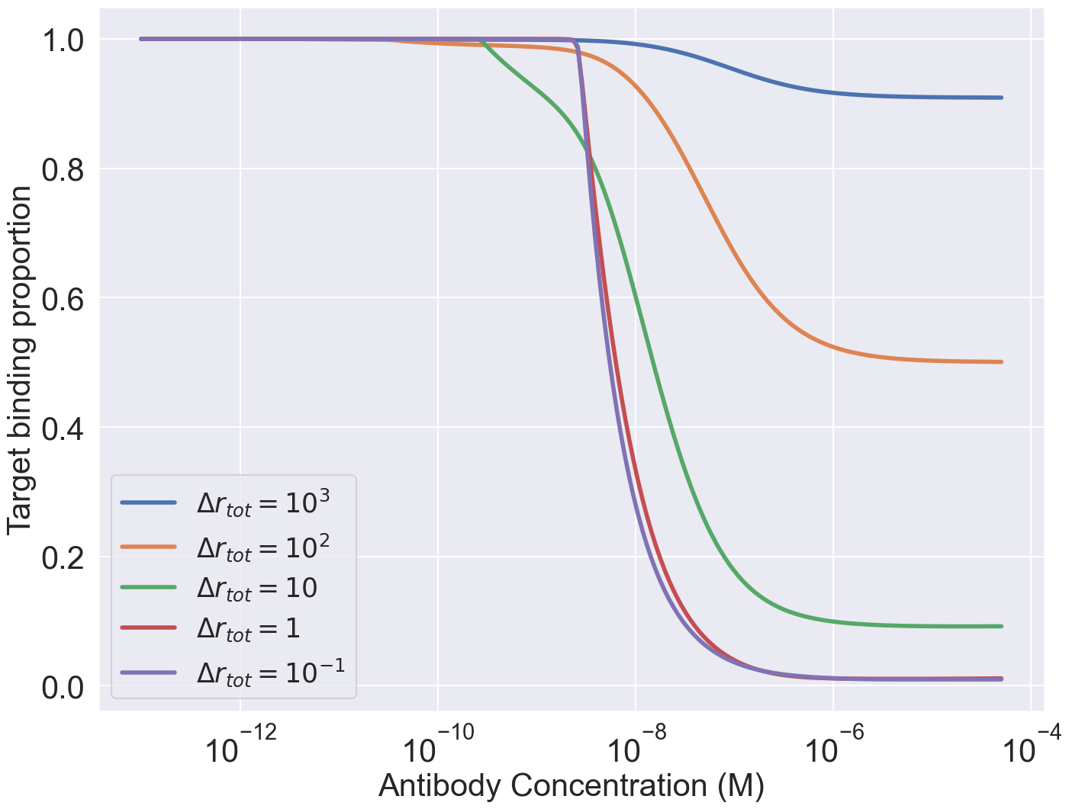
Non target cells = 100xtarget cells

Slide 15
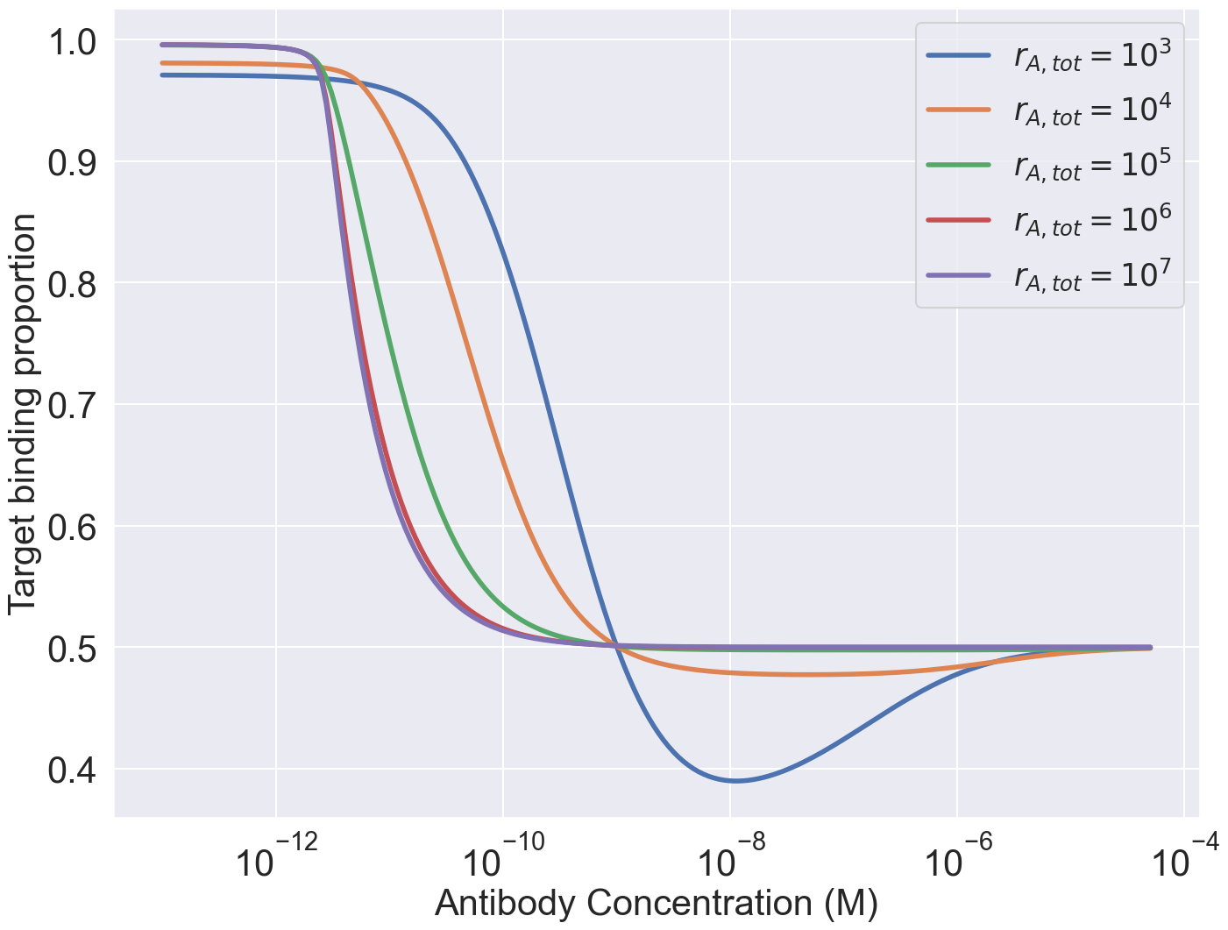
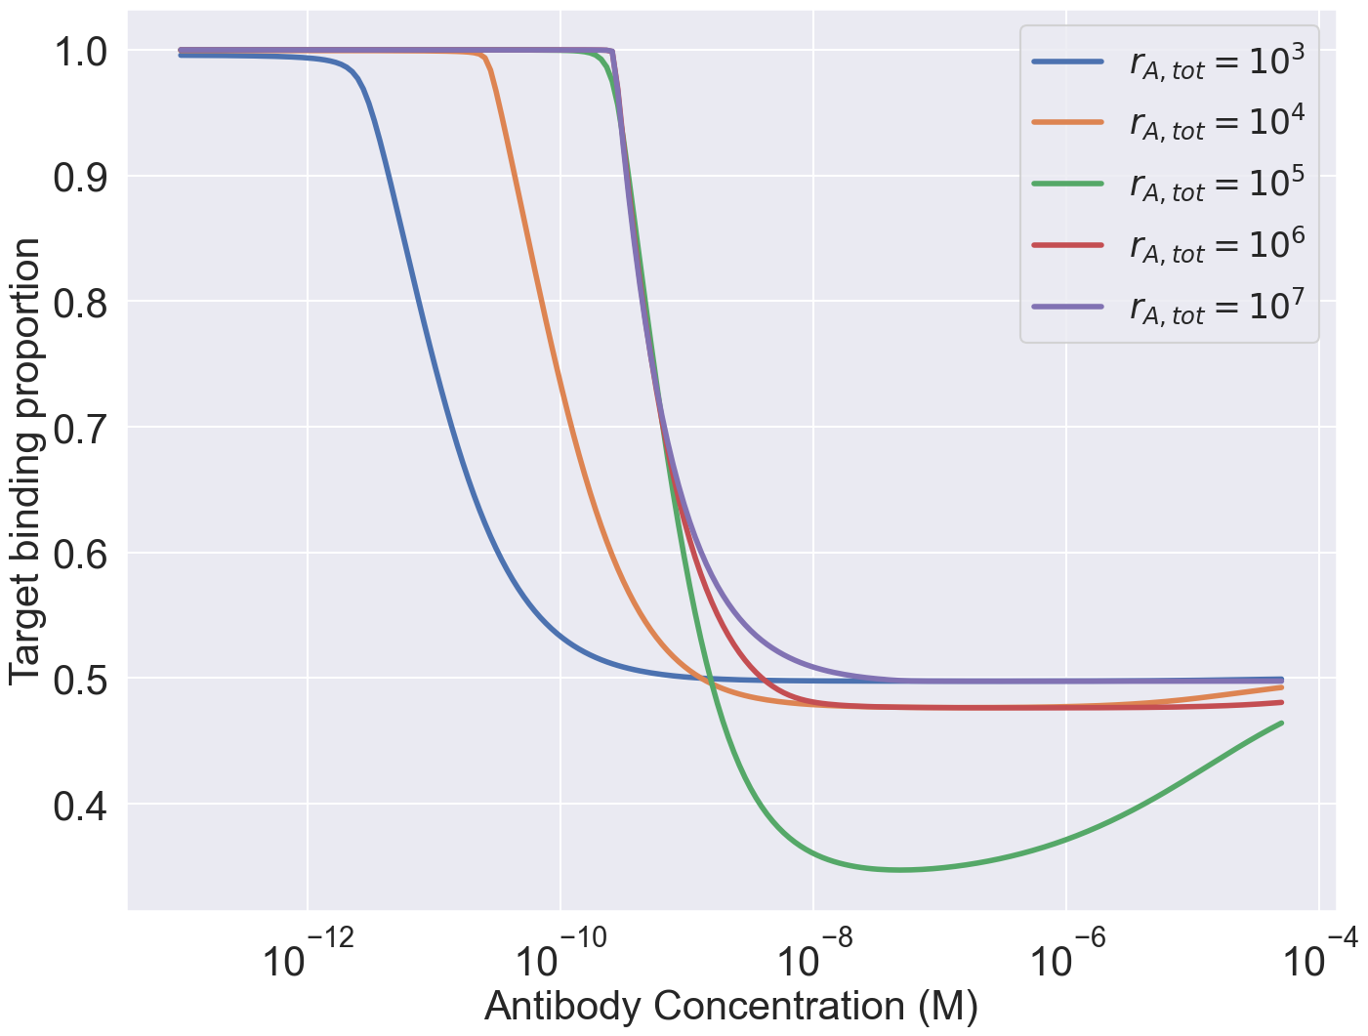
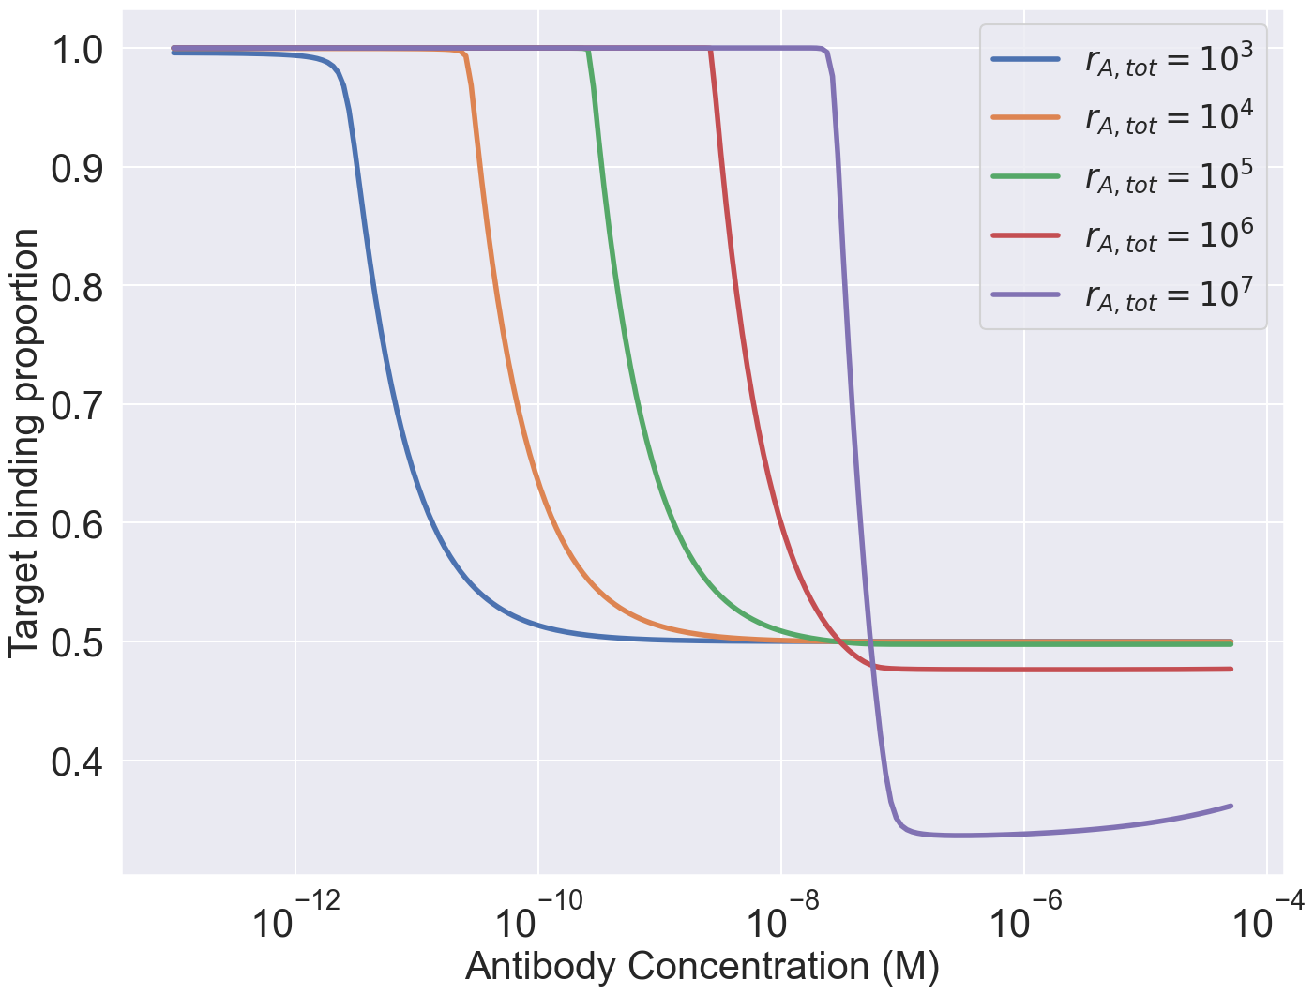
Expression levels same between target vs nontarget cells

Slide 16
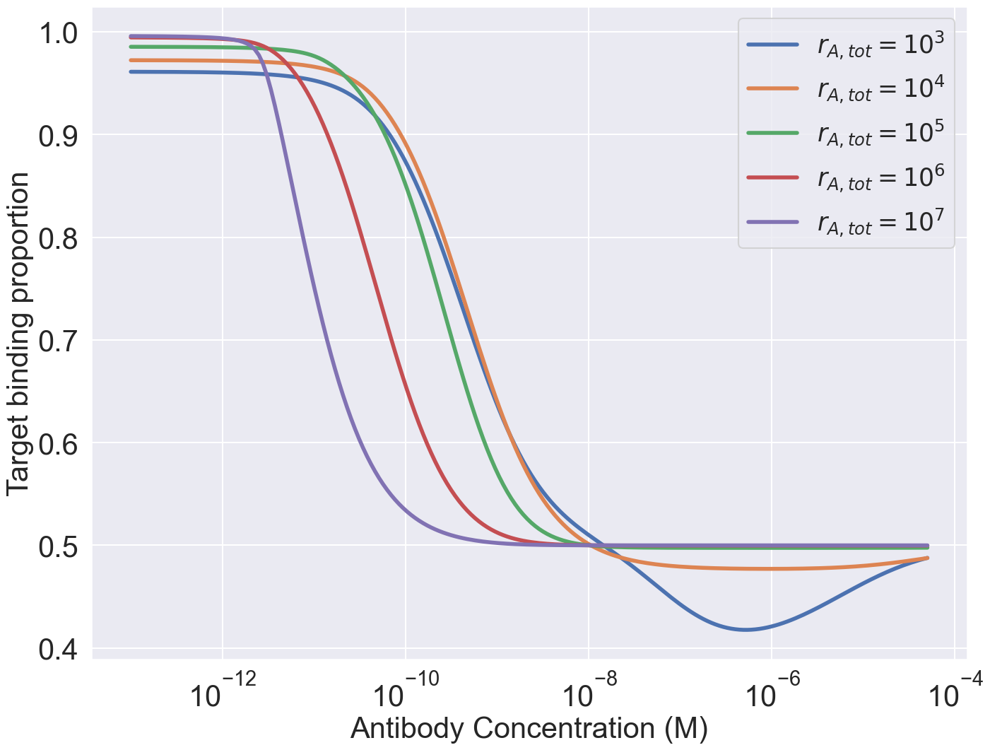
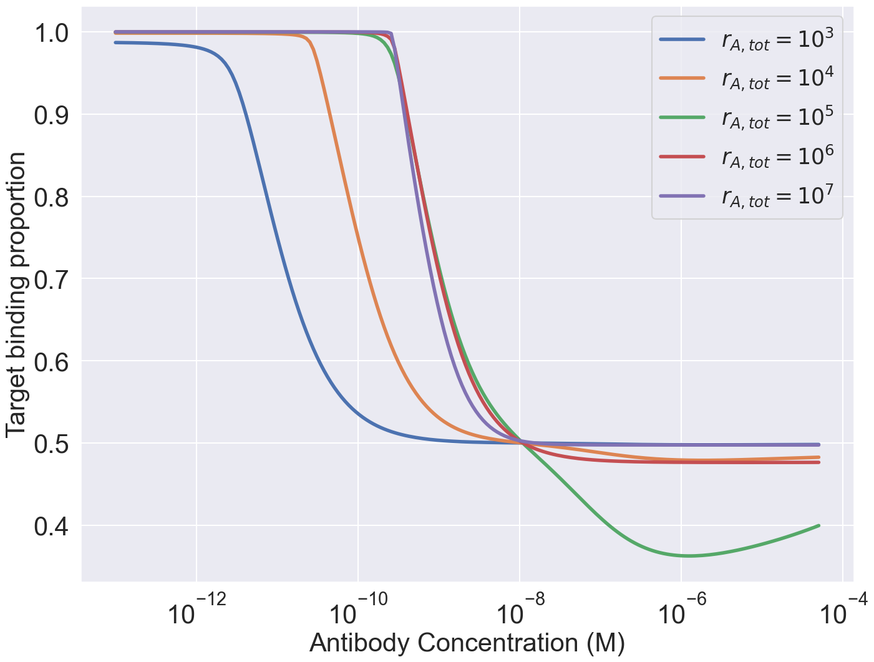

Expression levels same between target vs nontarget cells

Slide 18
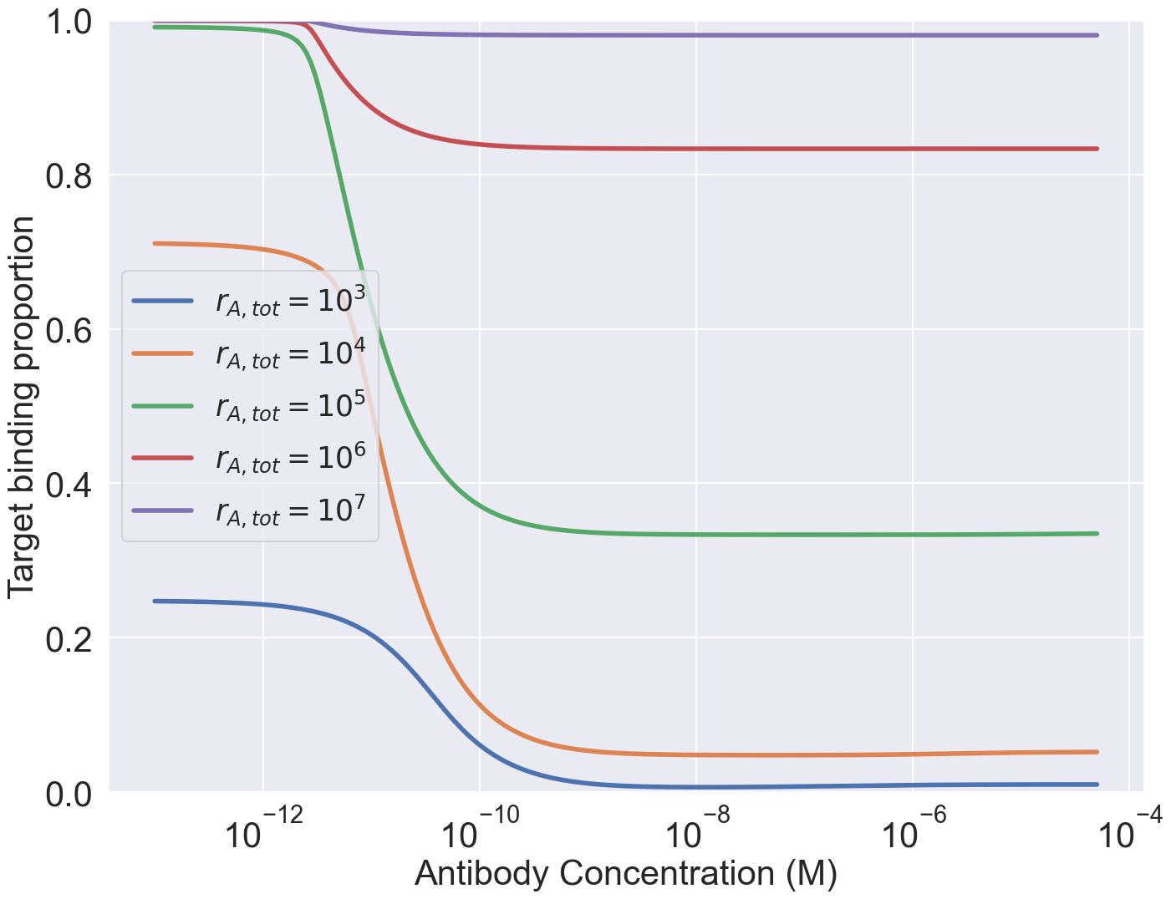
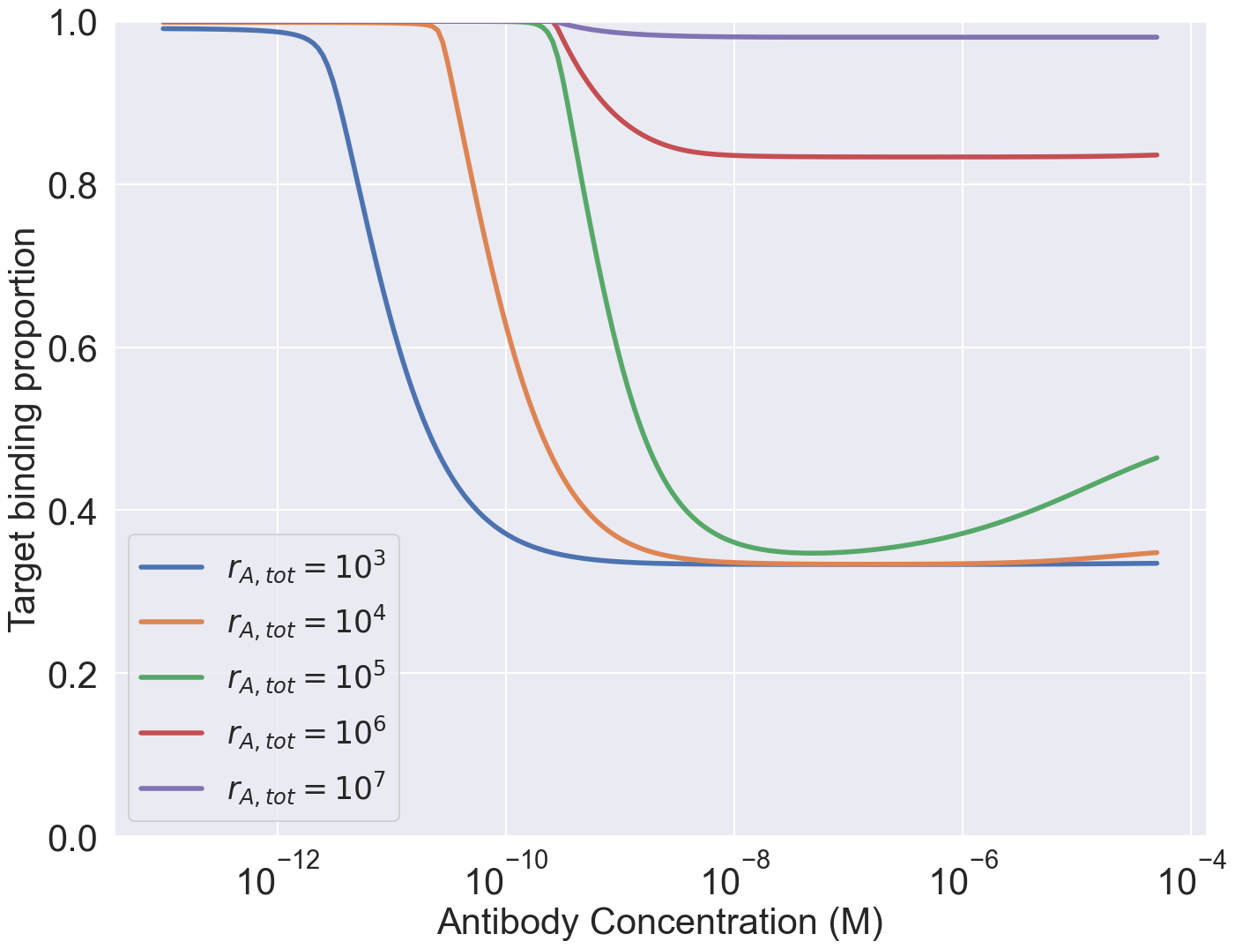
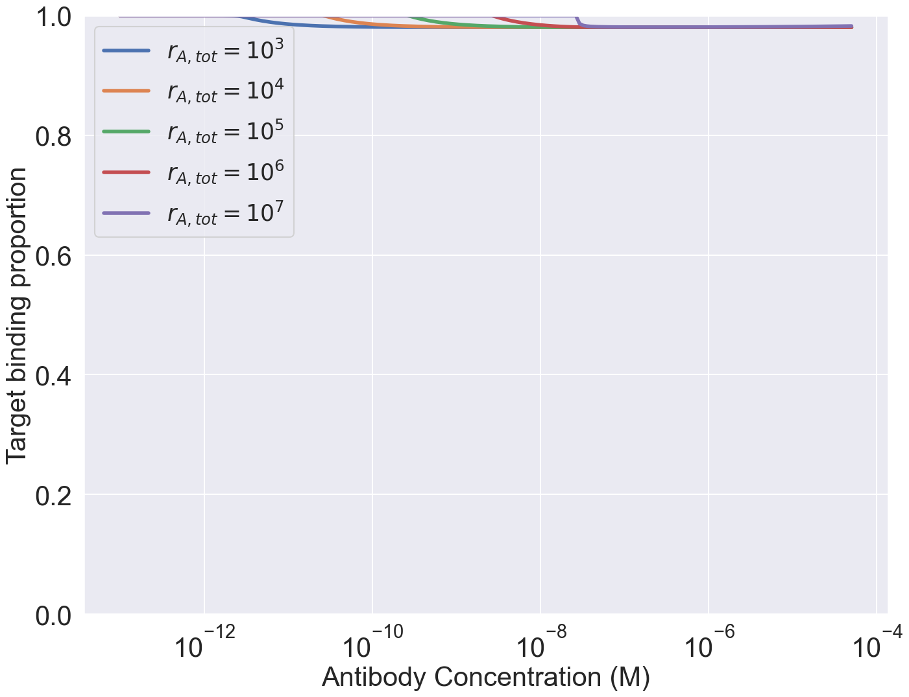
Target cell expression levels vary
Non target cell expressions levels = 10^5 for both targets

Slide 19
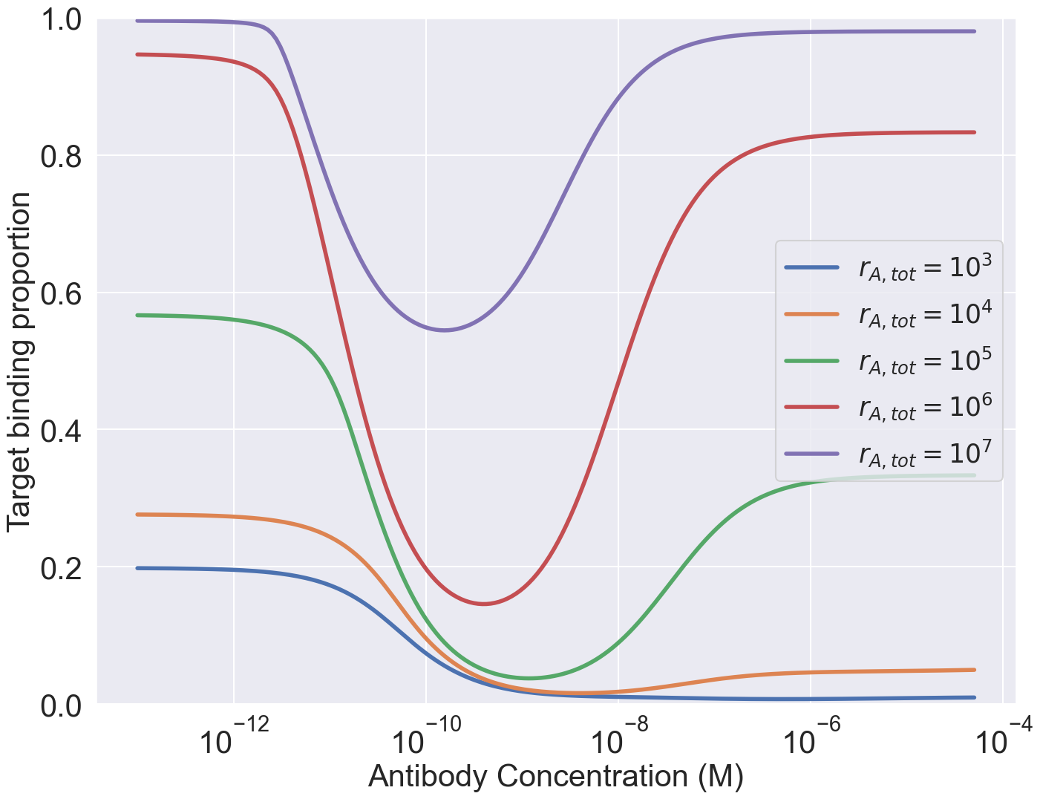
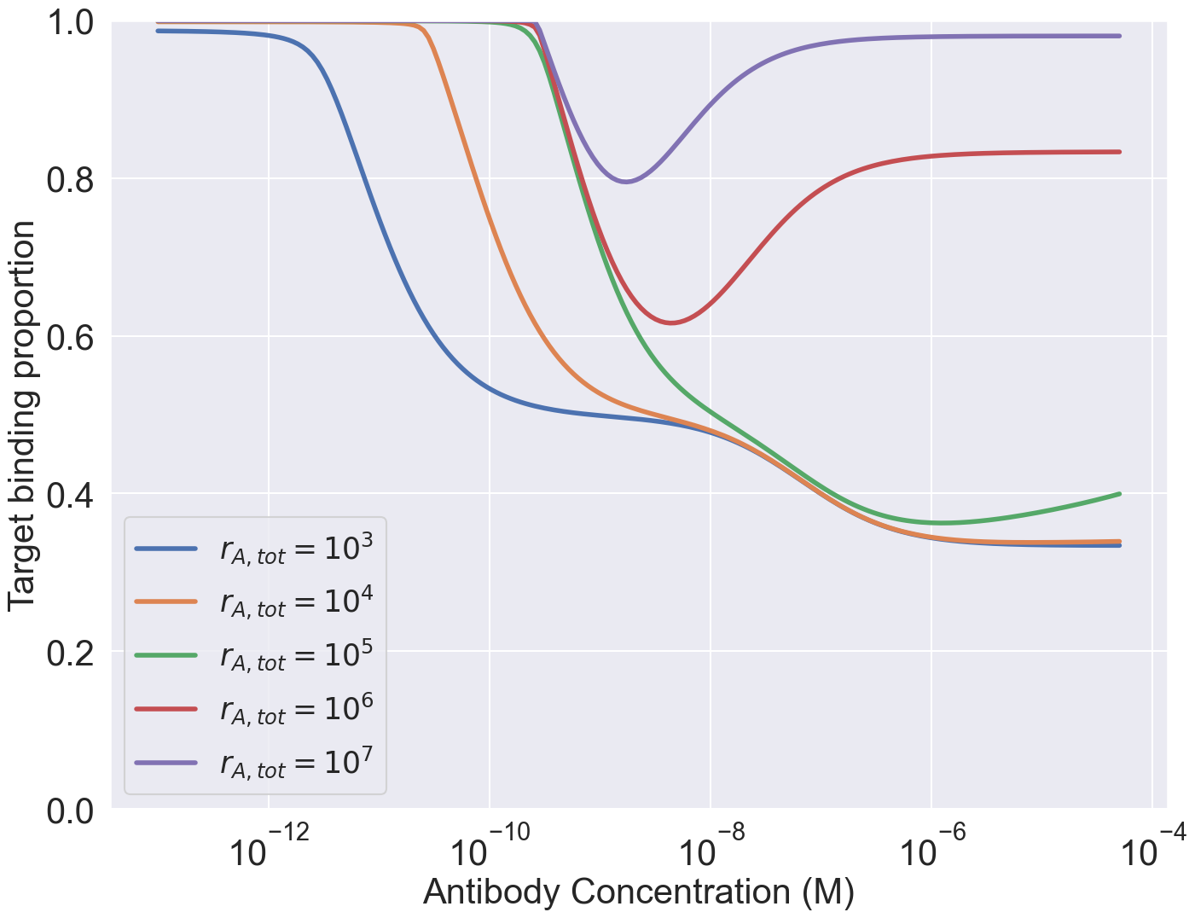

Target cell expression levels vary
Non target cell expressions levels = 10^5 for both targets

Slide 21
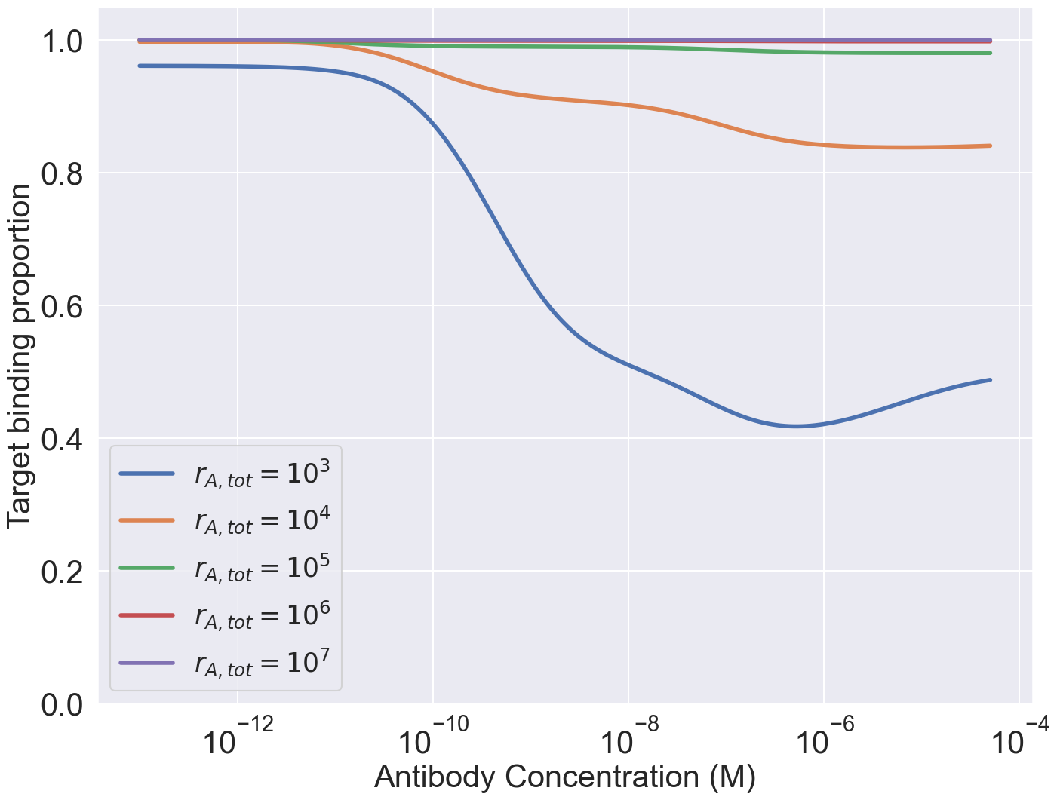
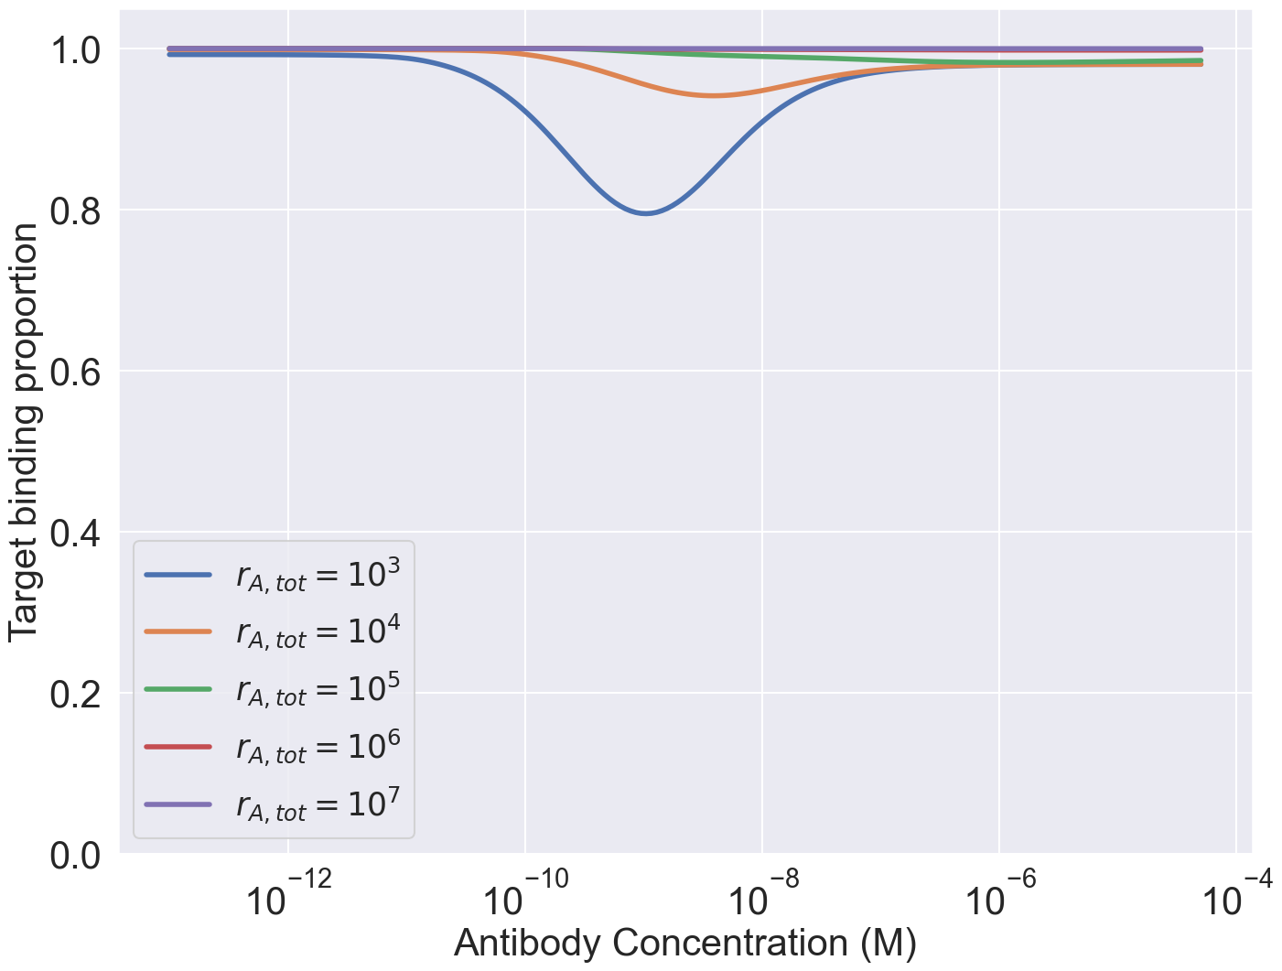
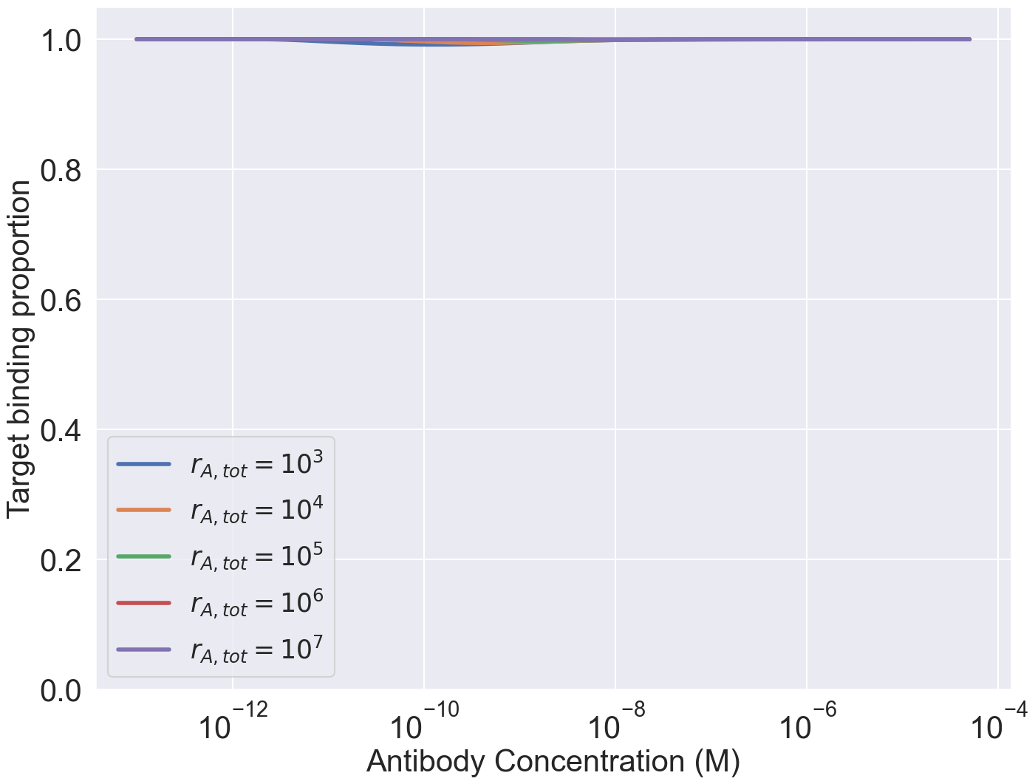
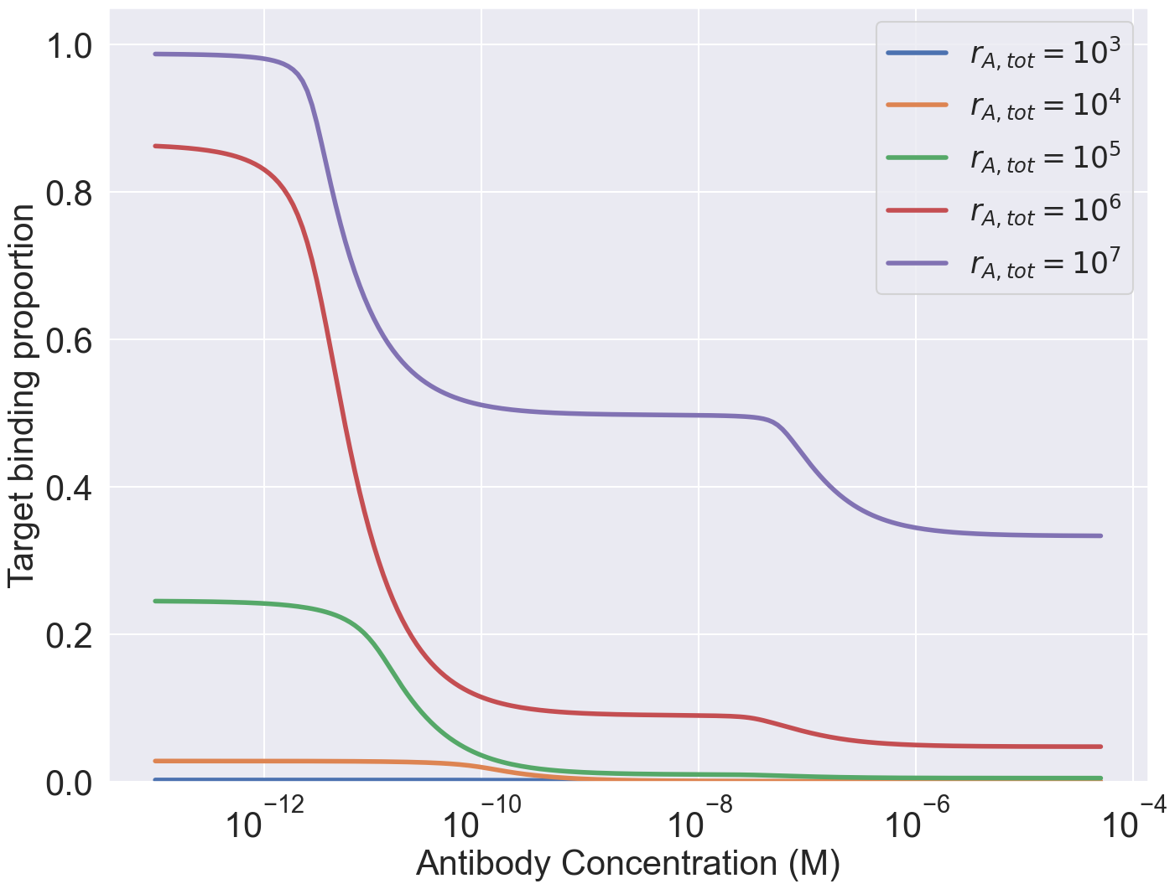
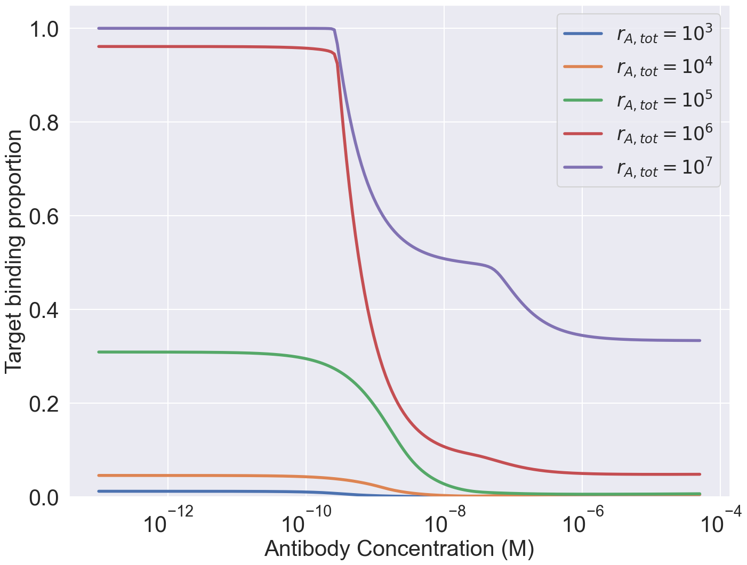
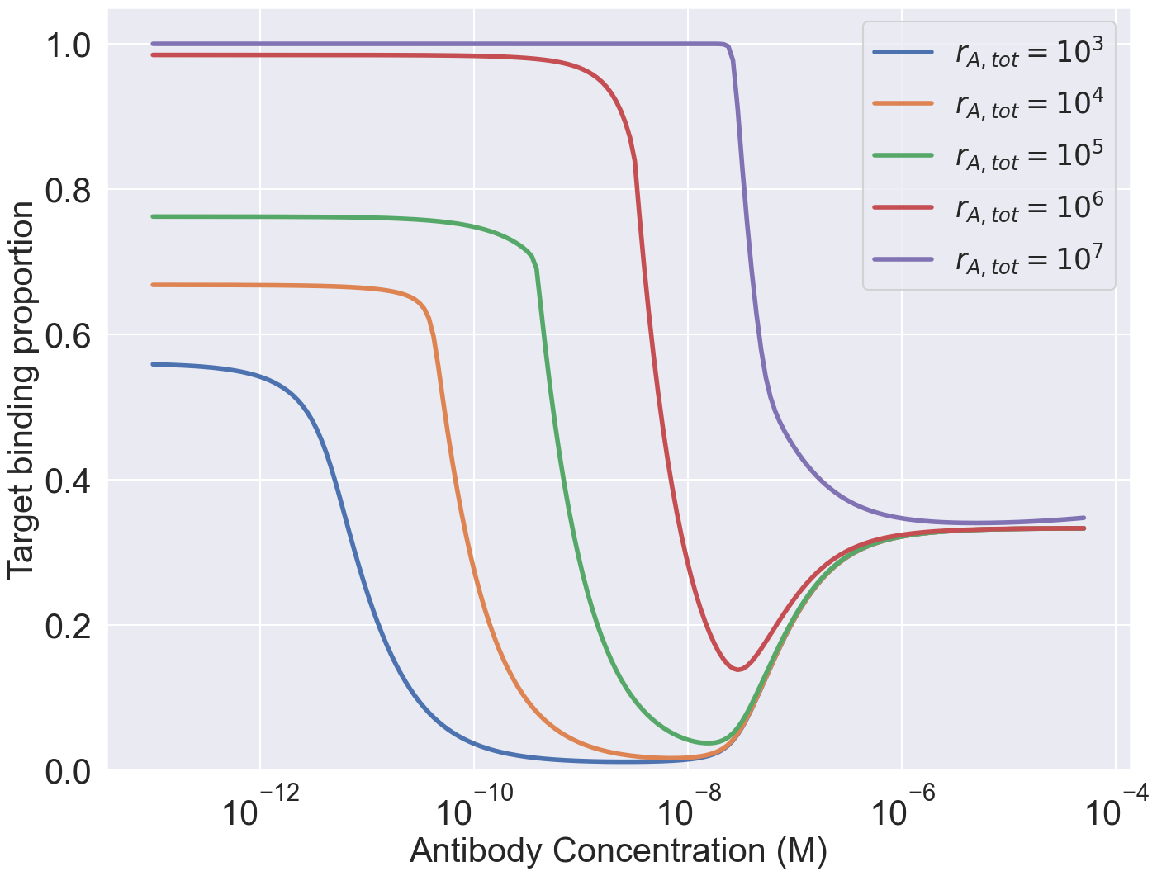
10^3
10^7

Slide 22
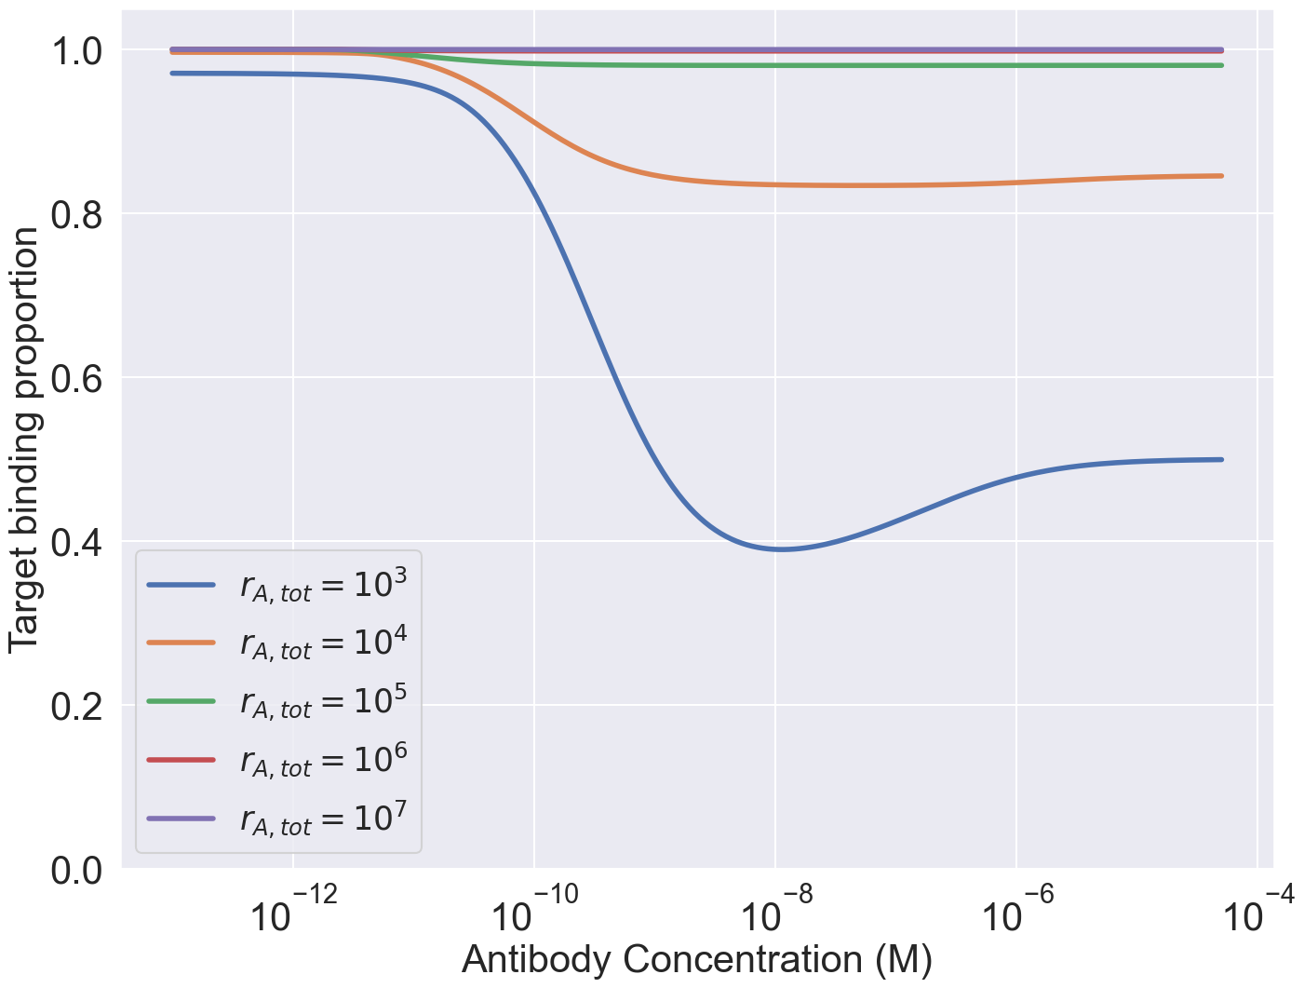
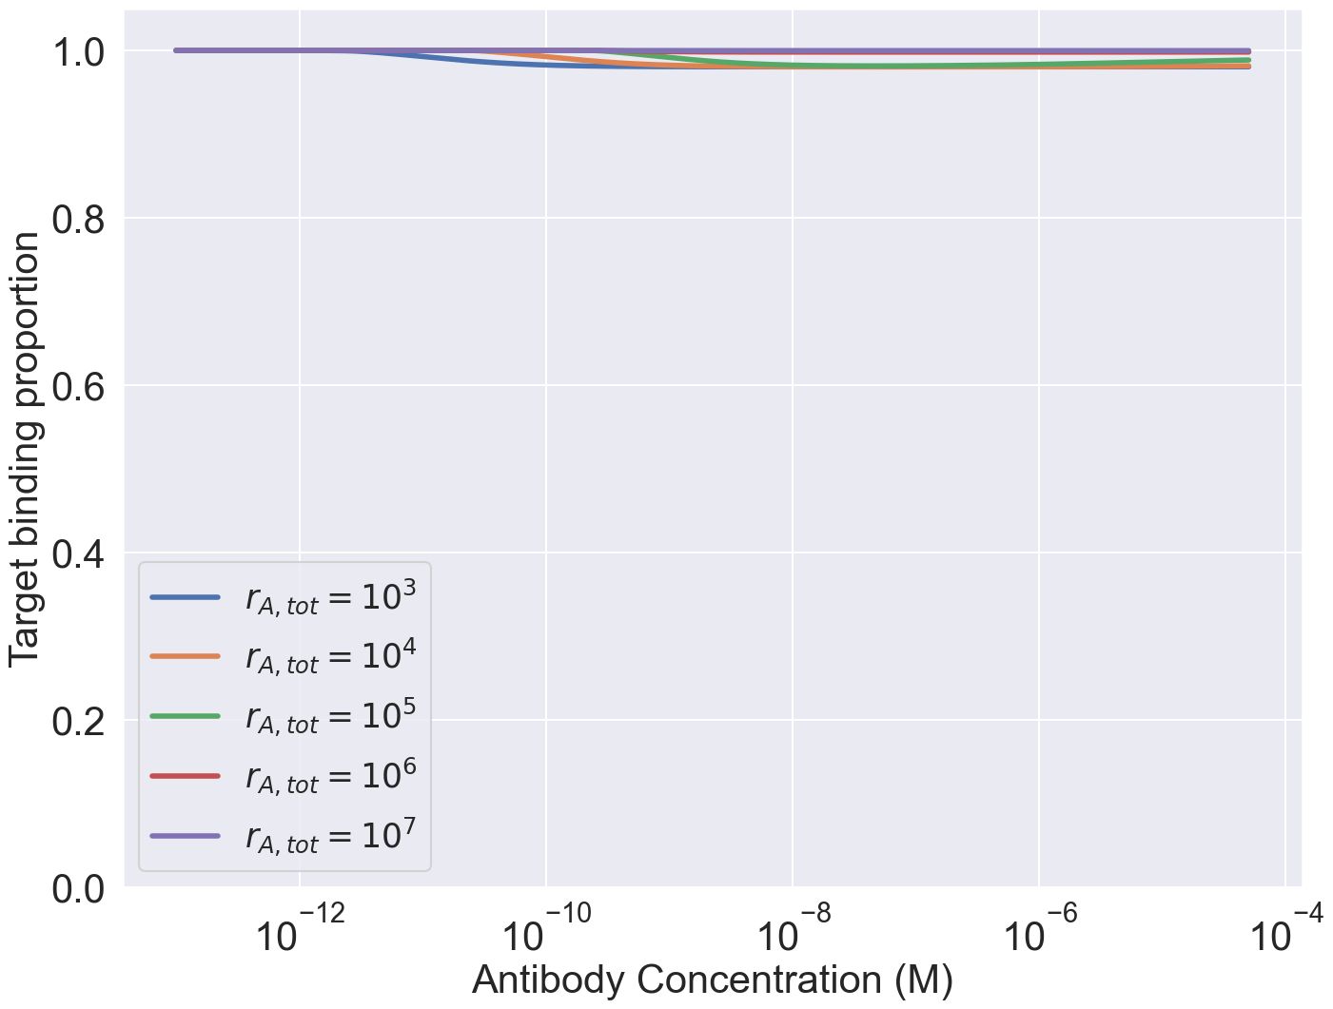
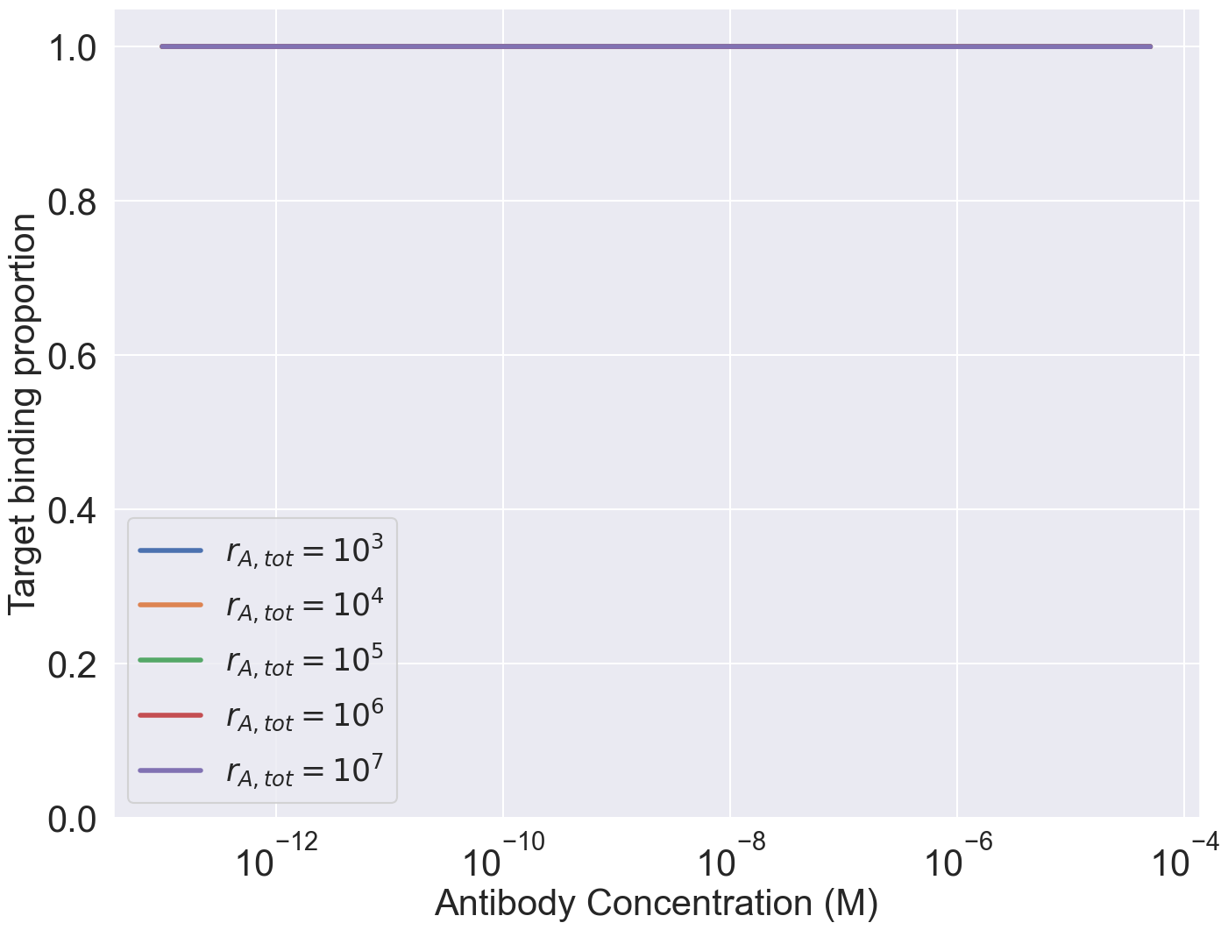



10^3
10^7

Slide 23
A strong
B weak
A strong
B strong
10^3 nontarget cell expression for A and B

Slide 24
A strong
B weak
A strong
B strong
10^7 nontarget cell expression for A and B

Slide 25




Receptor Occupancy EC50 plots
Rtot_target =10^5
Rtot_target =10^3
KD(target) =
1nM
KD(target)=
100nM
D=10^-14 (m^2s^-1)

Slide 26




Bound Antibody EC50 plots
Rtot_target =10^3
Rtot_target =10^5
KD(target) =
1nM
!!Wrong KD axis!!
KD(target)=
100nM
D=10^-14 (m^2s^-1)

Slide 27






10^3
10^7

Slide 28
Work for Rachel

Slide 29


Single duel-expressing cell binding
CD4 Occupancy
PD1 Occupancy
1000 receptors for both CD4 and PD1

Slide 30

Bound Antibody Number

Slide 31


CD4 Occupancy
PD1 Occupancy
10^5 receptors per cell
100 receptors per cell

Slide 32

Bound Antibody Number

Slide 33


CD4 Occupancy
PD1 Occupancy
100 receptors per cell
1e5 receptors per cell

Slide 34

Bound Antibody Number

Slide 35

Multicell Selectivity
1000 receptors for each target on dual expressing cell
1000 receptors on both single expressing cells
Target cell number =10^5
Non-target cell number =10^5 for both types

Slide 36


CD4=10^2, PD1=10^5 (dual expressing cells)
CD4=10^5, PD1=10^2 (dual expressing cells)
Both targets =10^2 on single expressing cells

Slide 37


CD4=10^2, PD1=10^5 (dual expressing cells)
CD4=10^5, PD1=10^2 (dual expressing cells)
Both targets =10^5 on single expressing cells

Slide 38

CD4=10^5, PD1=10^5 (dual expressing cells)
Both targets =10^5 on single expressing cells

Slide 39


CD4=10^4, PD1=10^2 (dual expressing cells)
CD4=10^2, PD1=10^4 (dual expressing cells)
Both targets =10^3 on single expressing cells

Slide 40



CD4=10^2, PD1=10^4 (dual expressing cells)
CD4=10^2, PD1=10^5 (dual expressing cells)
CD4=10^3, PD1=10^4 (dual expressing cells)
Both targets =10^3 on single expressing cells
Nontarget cell number = 10 x target cell number

